Slide 1
IBM Research AI
Please join the Slack community http://aif360.mybluemix.net/community
AI Fairness 360
Kush R. Varshney
krvarshn@us.ibm.com
@krvarshney
http://aif360.mybluemix.net https://github.com/ibm/aif360 https://pypi.org/project/aif360

Slide 2
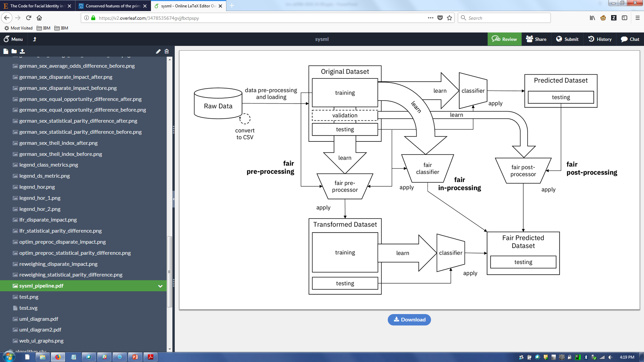
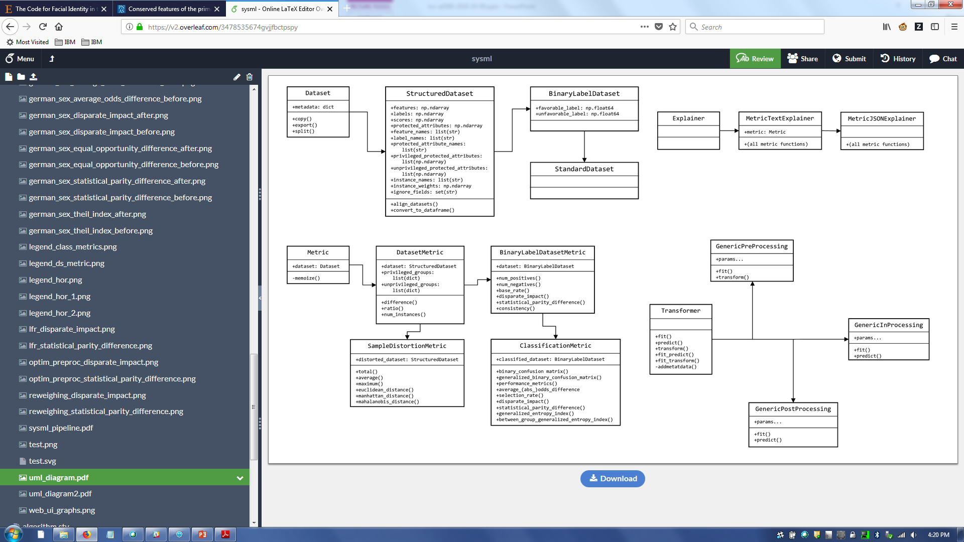
AI Fairness 360
Agenda
Trustworthy machine learning Algorithmic Fairness AI Fairness 360 Toolkit Which fairness metric? Which bias mitigation algorithm?
Please join the Slack community http://aif360.mybluemix.net/community

Slide 3
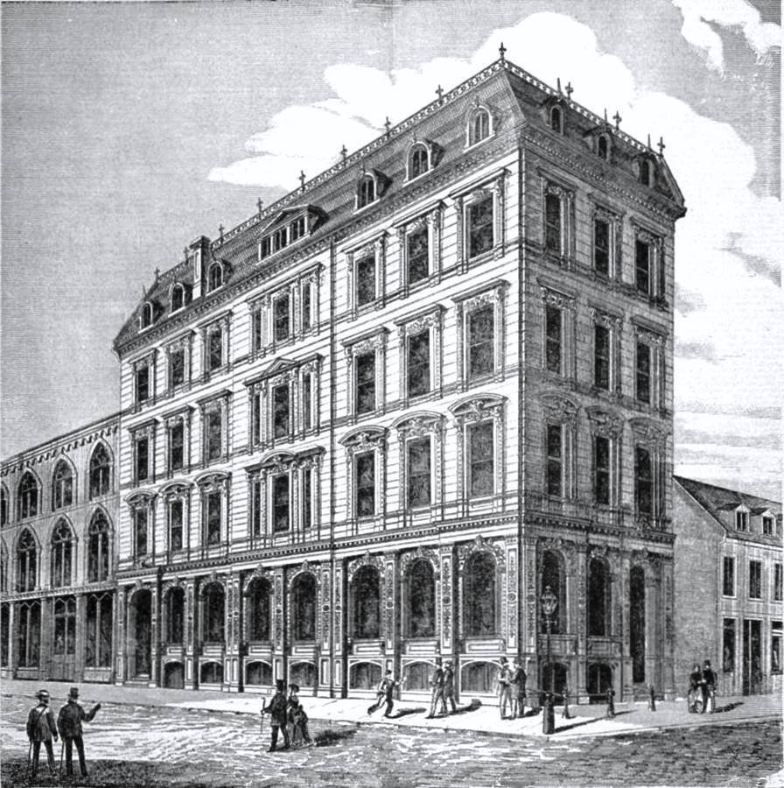
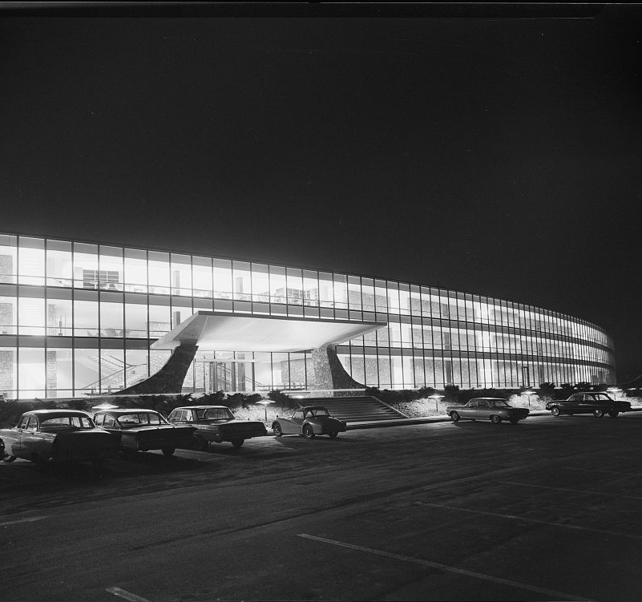
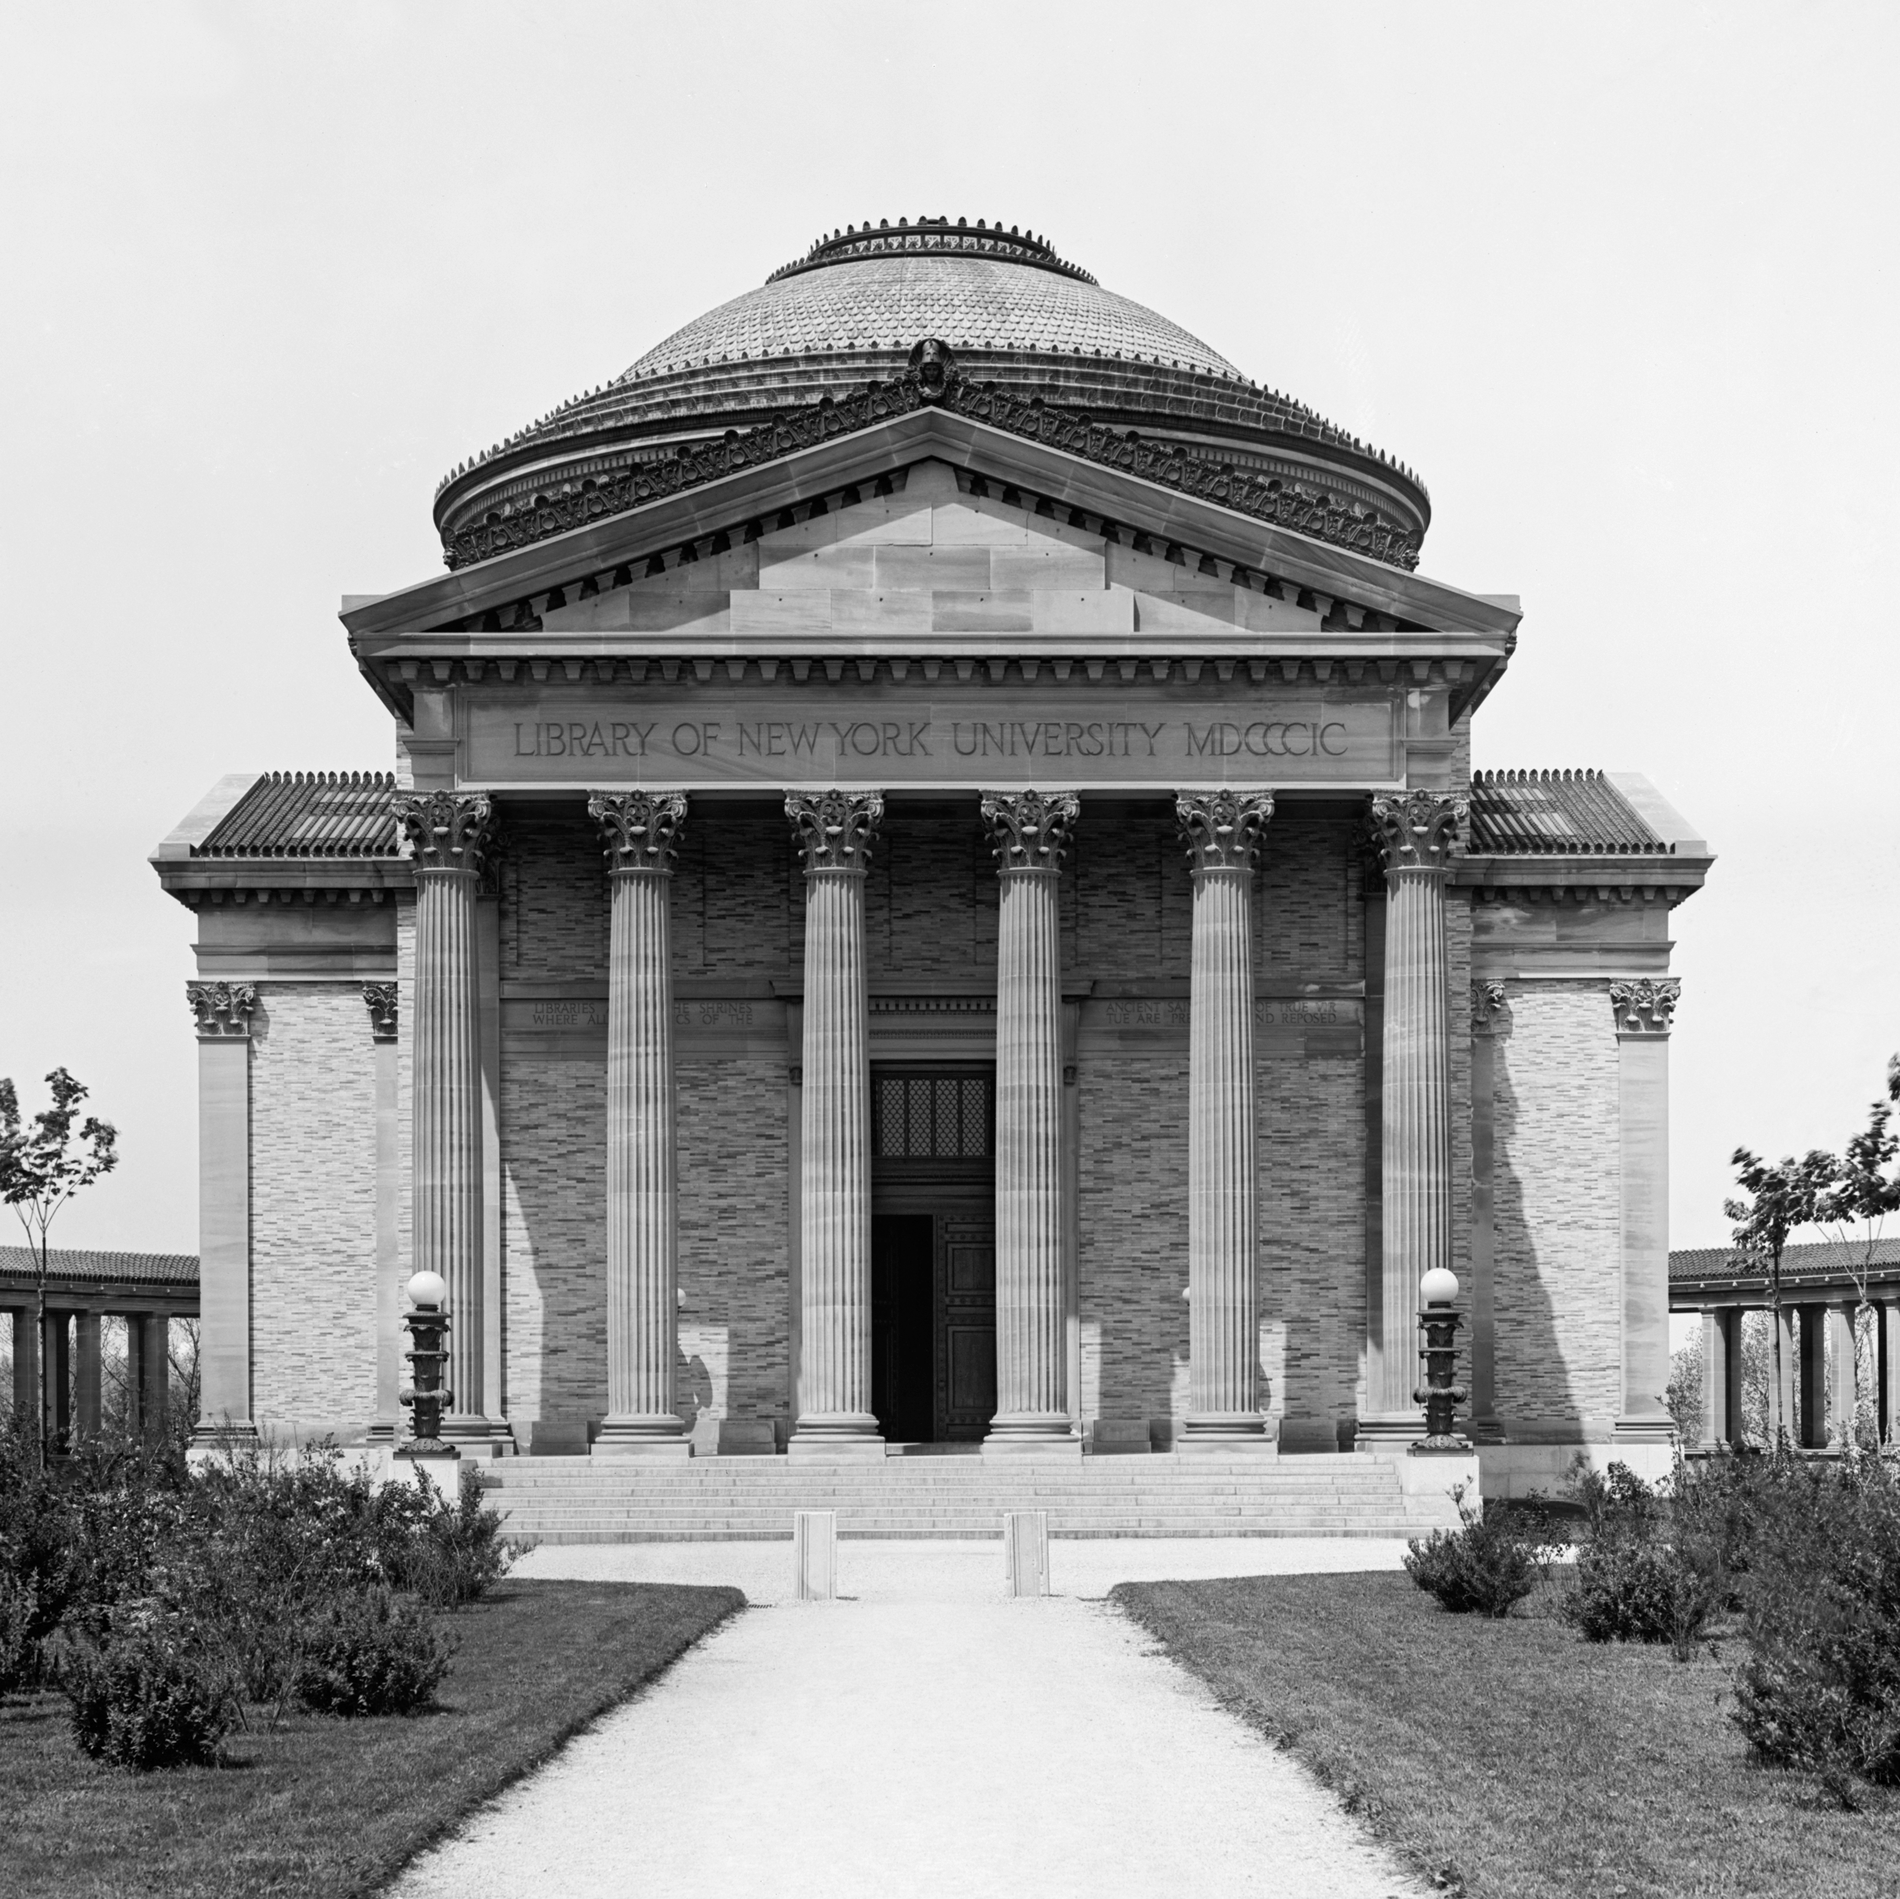
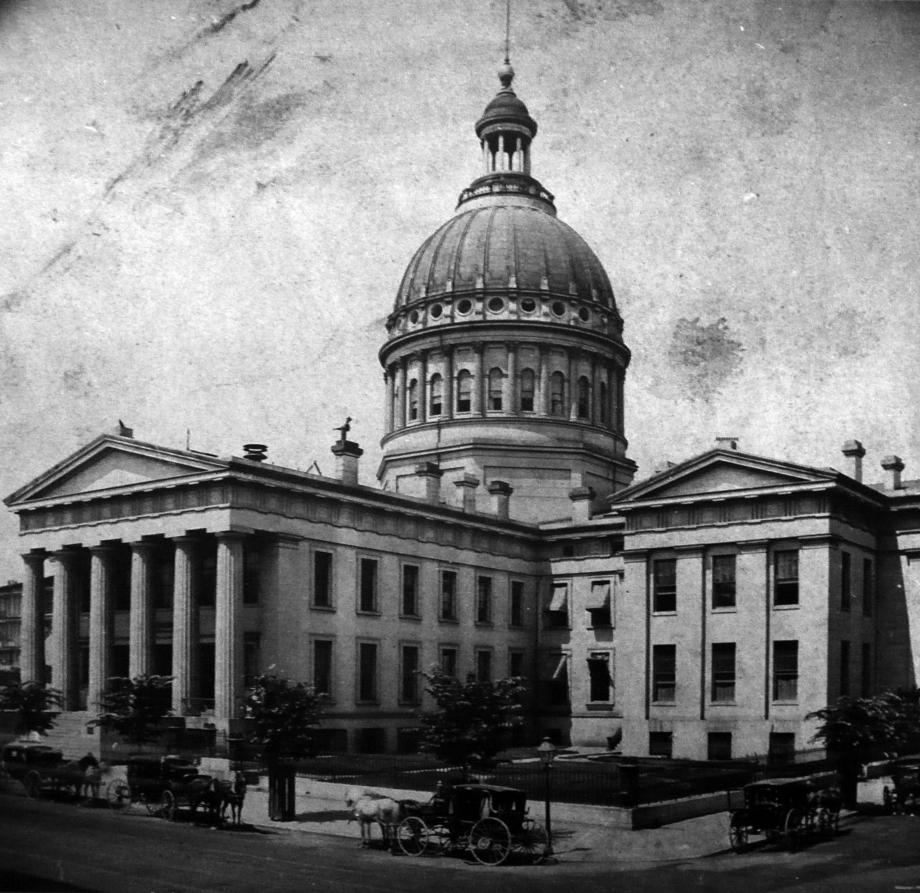
AI is now used in many high-stakes decision making applications
Credit
Employment
Admission
Sentencing

Slide 4

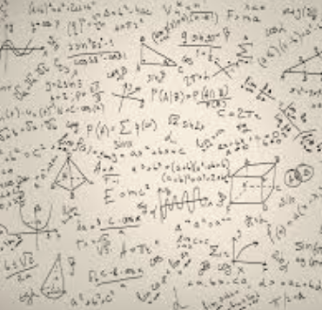

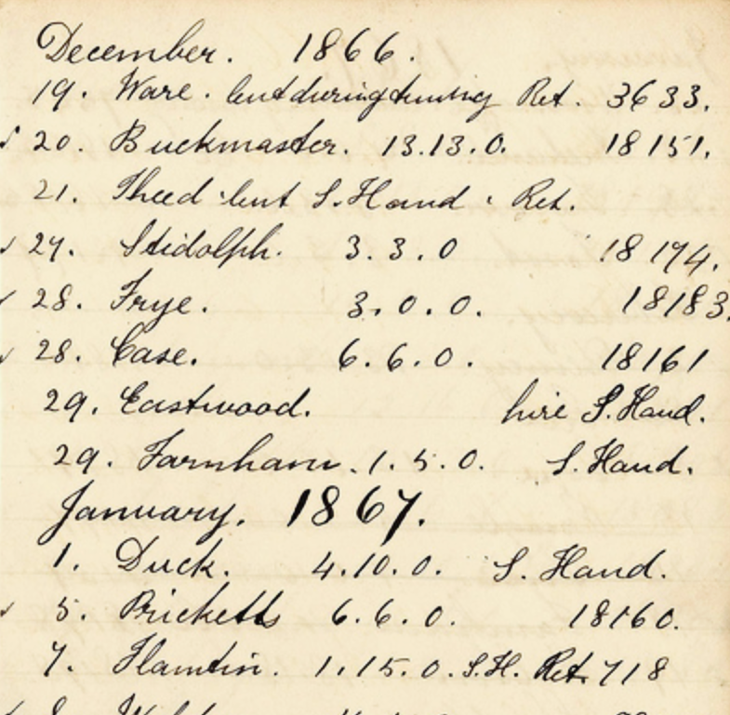
What does it take to trust a decision made by a machine? (Other than that it is 99% accurate)
Is it easy to understand?
Did anyone tamper with it?
Is it fair?
Is it accountable?

Slide 5
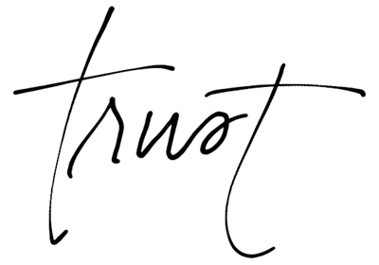
Trust

Slide 6
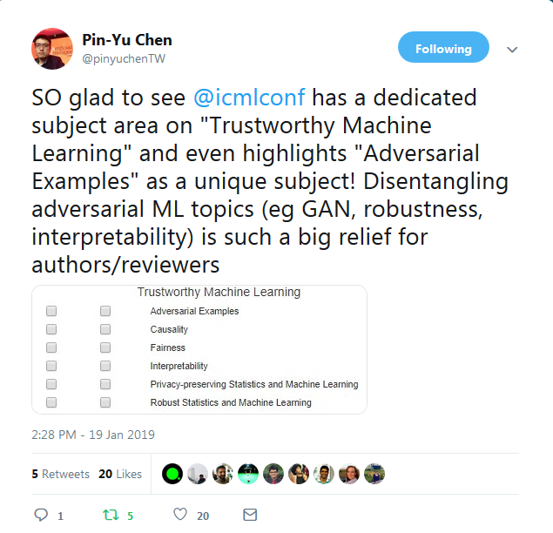
ICML’s Definition

Slide 7
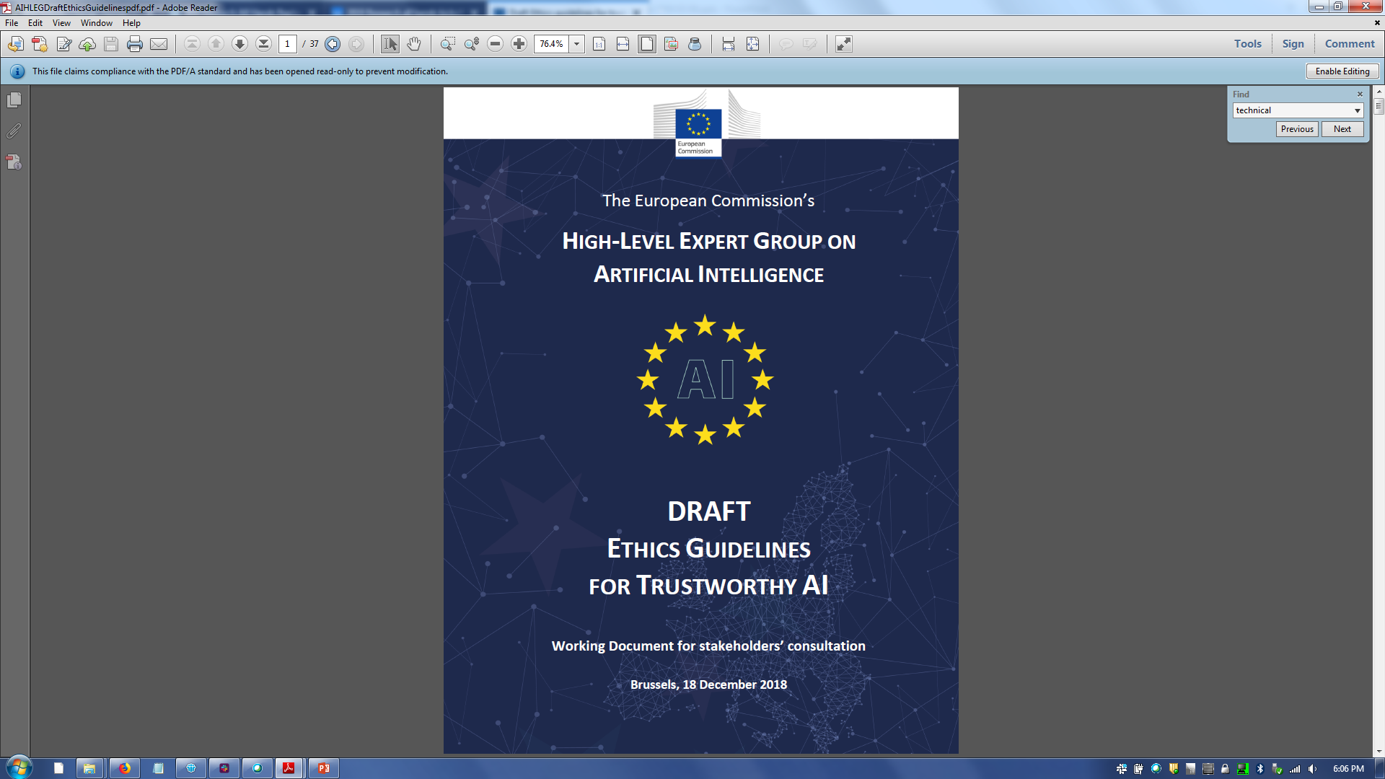
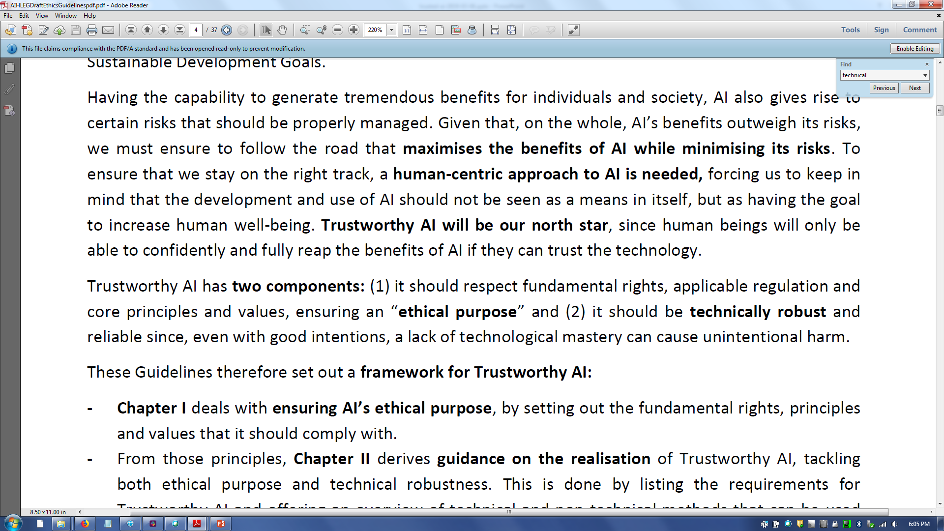
European Commission’s Definition

Slide 8
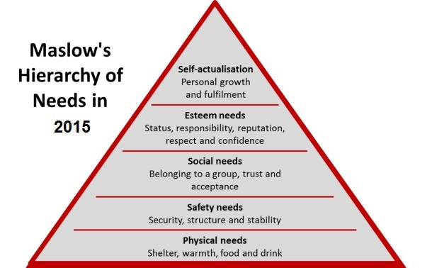
Maslow’s Hierarchy of Needs

Slide 9
Hierarchy of Needs for AI
transparency
safety and security
basic accuracy

Slide 10
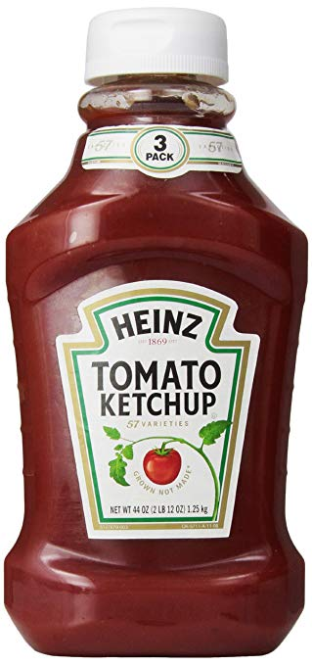
Analogy with Processed Food
Unadulterated ingredients
Transparent containers
Innovative sanitary food preparation
Factory tours
Pure Food and Drug Act
Labels
Tamper-resistant packaging
Blockchain

Slide 11

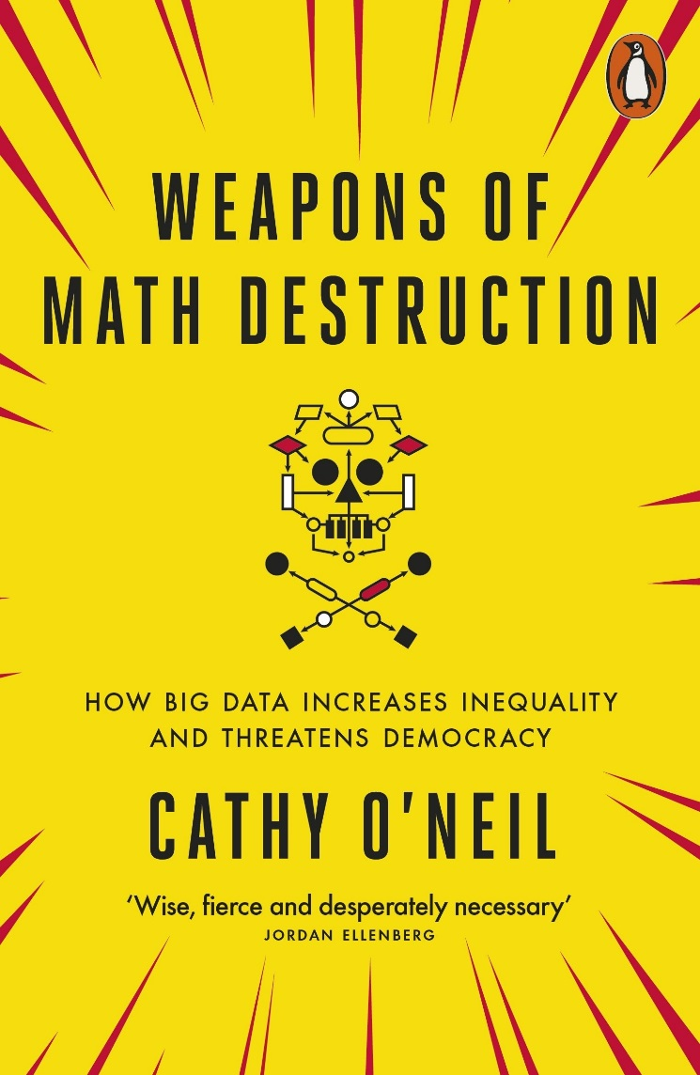
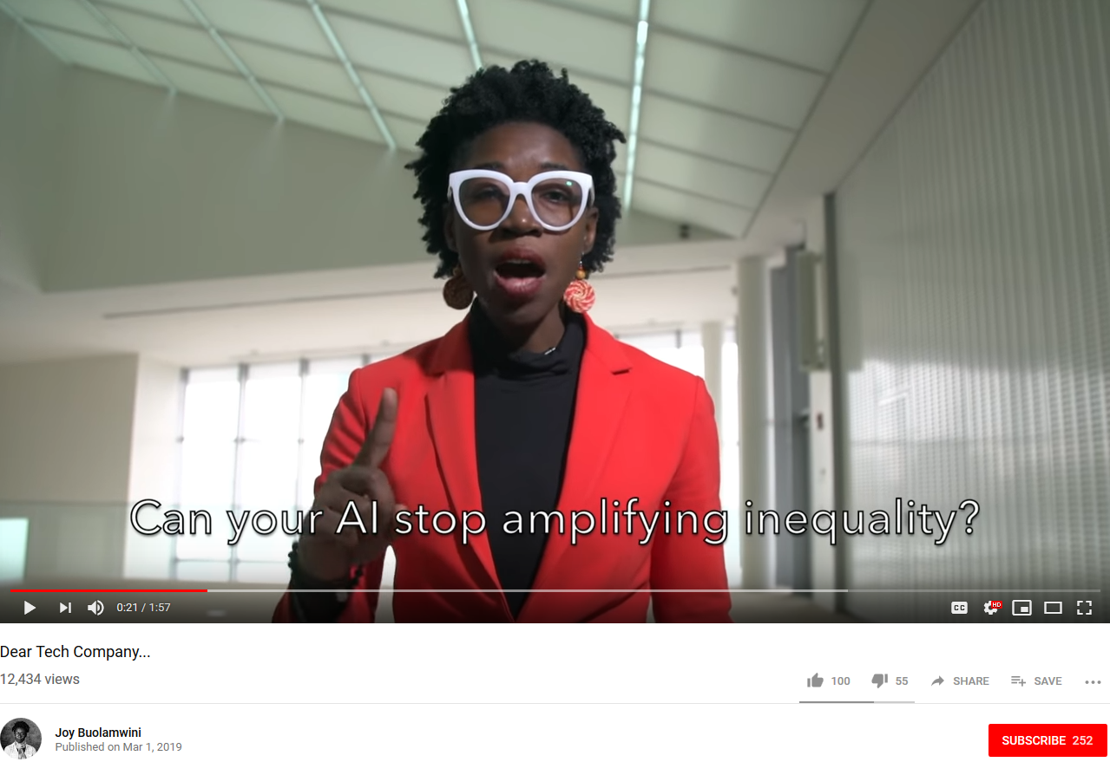
Analogy with Processed Food

Slide 12
Trustworthy Machine Learning and AI
Data quality
Value alignment
Distribution shift
Poisoning and adversarial samples
Fairness
Interpretability
FactSheets
Blockchain

Slide 13
AI Fairness 360
Agenda
Trustworthy machine learning Algorithmic Fairness AI Fairness 360 Toolkit Which fairness metric? Which bias mitigation algorithm?
Please join the Slack community http://aif360.mybluemix.net/community

Slide 14
Glossary
Label – a value corresponding to an outcome
Favorable label – a label whose value corresponds to an outcome that provides an advantage to the recipient
Feature – an attribute containing information for predicting the label
Model – a function that takes features as input and predicts labels as output
Classifier – a model that predicts categorical labels from features
Score – a continuous value output from a classifier; applying a threshold to a score results in a predicted label
Machine learning – a general approach for determining models from data
Training data – a dataset from which a model is learned

Slide 15
Glossary
Protected attribute – an attribute that partitions a population into groups whose outcomes should have parity; examples include race, gender, caste, and religion
Privileged protected attribute – a value of the protected attribute indicating a group that has historically been at systematic advantage
Group fairness – the goal of groups defined by protected attributes receiving similar treatments or outcomes
Individual fairness – the goal of similar individuals receiving similar treatments or outcomes
Bias – a systematic error; in the context of fairness, we are concerned with unwanted bias that places privileged groups at systematic advantage and unprivileged groups at systematic disadvantage
Fairness metric – a quantification of unwanted bias in training data or models
Explainer – functionality for providing details on or causes for fairness metric results

Slide 16
Glossary
Transformer – a procedure that modifies a dataset
Bias mitigation algorithm – a procedure for reducing unwanted bias in training data or models
Pre-processing algorithm – a bias mitigation algorithm that is applied to training data
In-processing algorithm – a bias mitigation algorithm that is applied to a model during its training
Post-processing algorithm – a bias mitigation algorithm that is applied to predicted labels
Instance weight – a numerical value that multiplies the contribution of a data point in a model

Slide 17
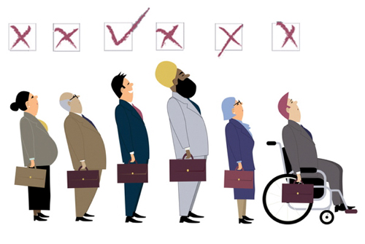
What is unwanted bias?
Discrimination becomes objectionable when it places certain privileged groups at systematic advantage and certain unprivileged groups at systematic disadvantage
Illegal in certain contexts
(Barocas and Selbst, 2017)

Slide 18
Where does it come from?
Unwanted bias in training data yields models with unwanted bias that scale out
Prejudice in labels
Undersampling or oversampling
(Barocas and Selbst, 2017)

Slide 19
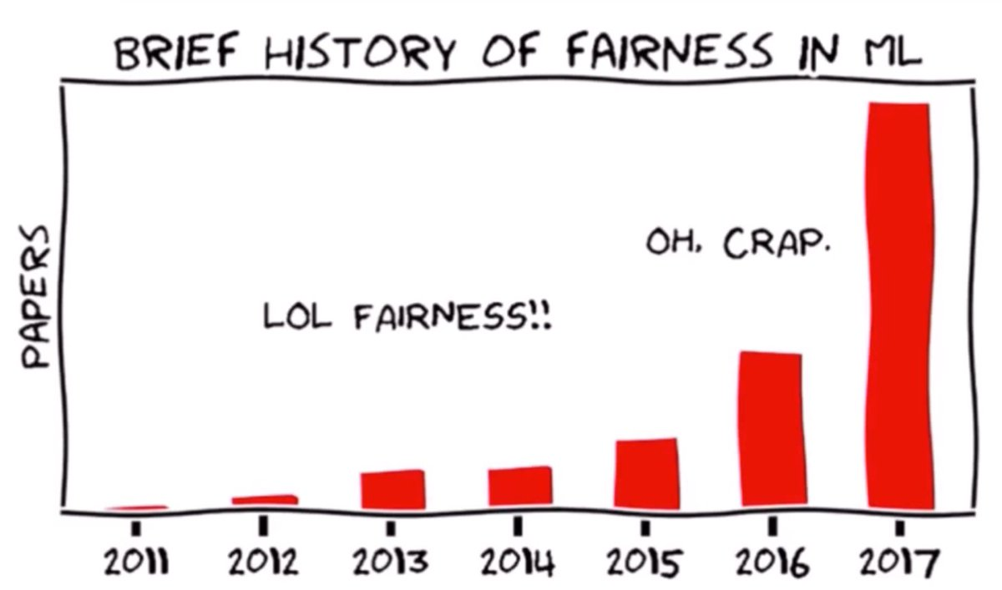
(Hardt, 2017)

Slide 20
21
definitions of fairness
(Narayanan, 2018)

Slide 21
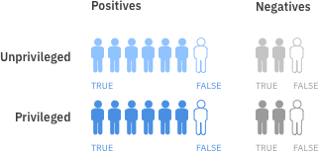
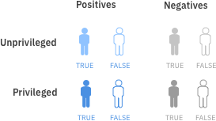
Group fairness metrics
situation 1
legend

Slide 22
Group fairness metrics
situation 2
legend

Slide 23
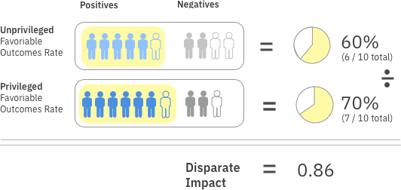
Group fairness metrics
disparate impact
legend

Slide 24
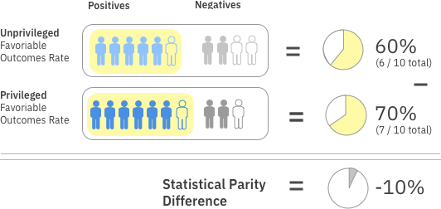
Group fairness metrics
statistical parity difference
legend

Slide 25
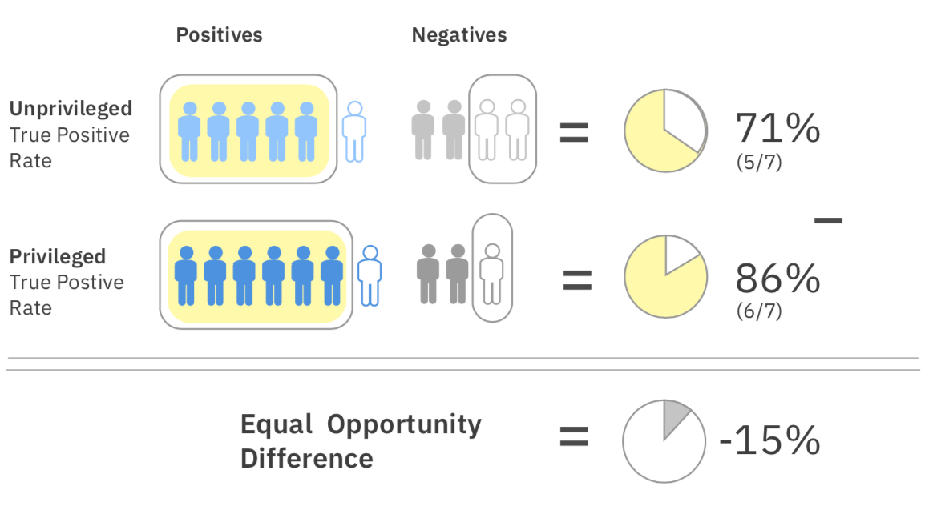
Group fairness metrics
equal opportunity difference
71%
(5/7 positives)
legend

Slide 26
Why are there so many definitions? 21 (or more) definitions of fairness
There is no one definition of fairness applicable in all contexts
Some definitions even conflict
Requires a comprehensive set of fairness metrics and bias mitigation algorithms
Also requires some guidance to industry practitioners

Slide 27
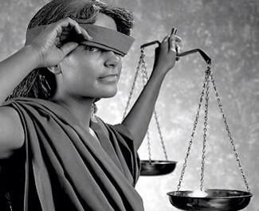
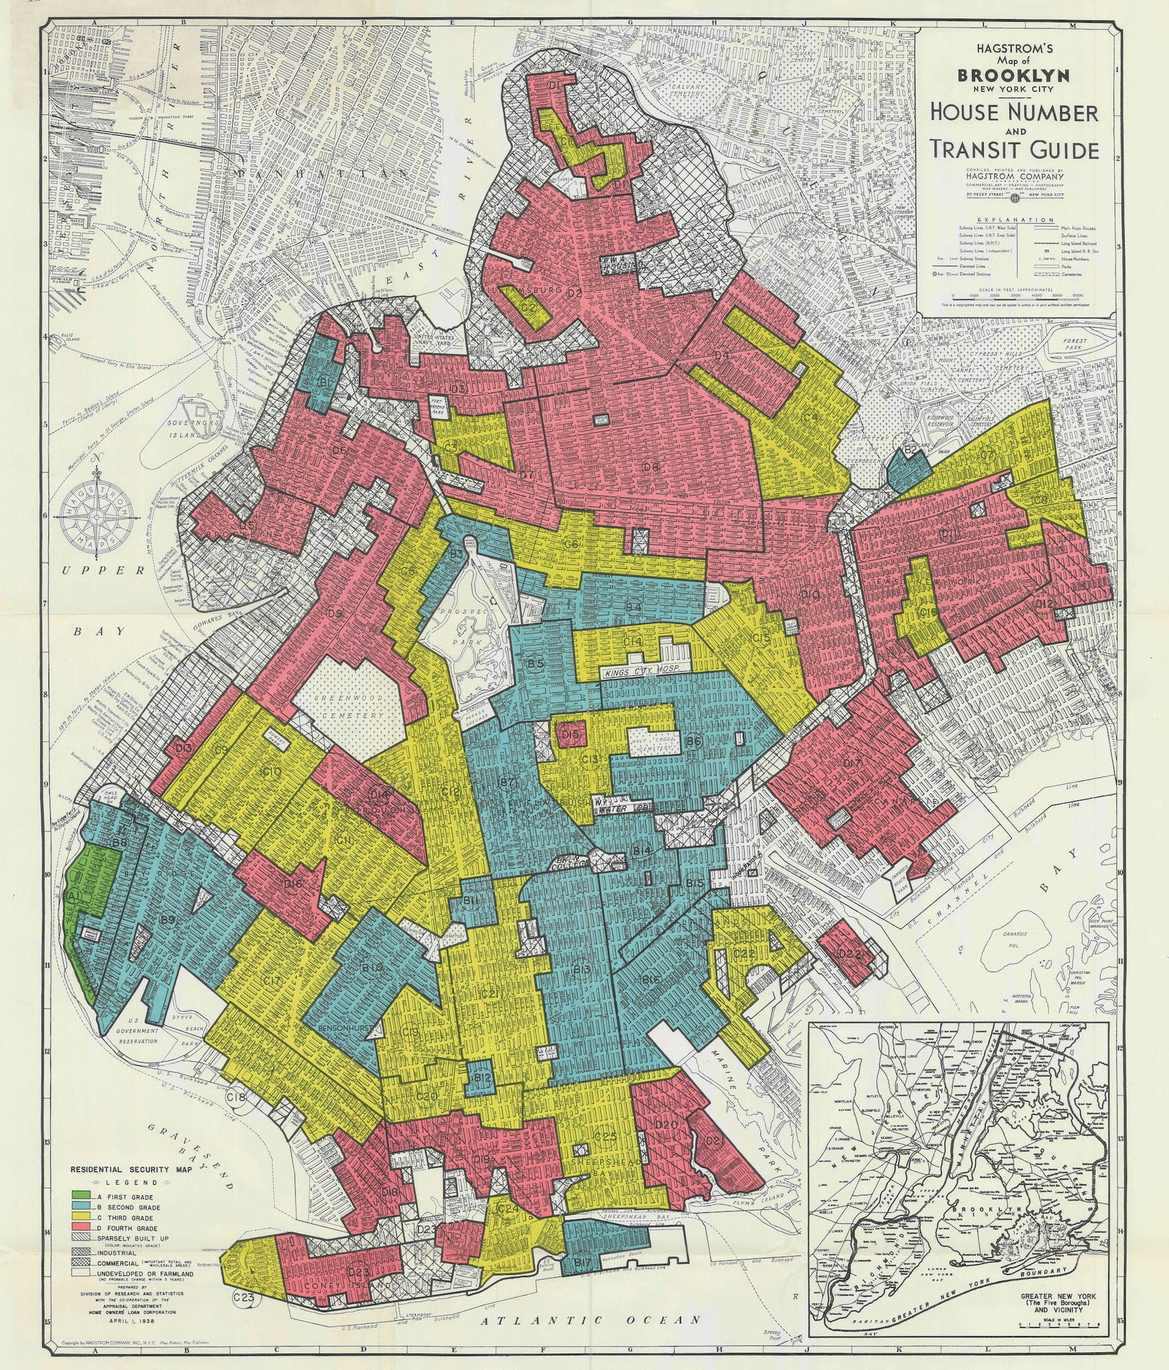
Bias mitigation is not easy Cannot simply drop protected attributes because features are correlated with them

Slide 28
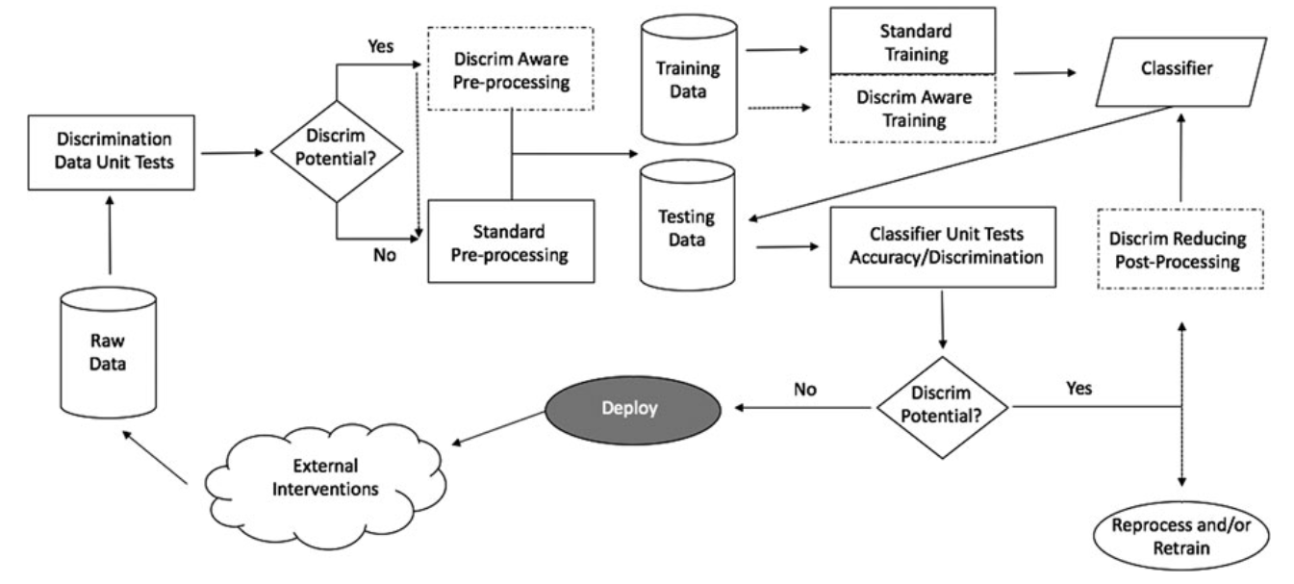
Fairness in building and deploying models
(d’Alessandro et al., 2017)

Slide 29
Fairness Measures | Framework to test given algorithm on variety of datasets and fairness metrics | https://github.com/megantosh/fairness_measures_code
Fairness Comparison | Extensible test-bed to facilitate direct comparisons of algorithms with respect to fairness measures. Includes raw & preprocessed datasets | https://github.com/algofairness/fairness-comparison
Themis-ML | Python library built on scikit-learn that implements fairness-aware machine learning algorithms | https://github.com/cosmicBboy/themis-ml
FairML | Looks at significance of model inputs to quantify prediction dependence on inputs | https://github.com/adebayoj/fairml
Aequitas | Web audit tool as well as python lib. Generates bias report for given model and dataset | https://github.com/dssg/aequitas
Fairtest | Tests for associations between algorithm outputs and protected populations | https://github.com/columbia/fairtest
Themis | Takes a black-box decision-making procedure and designs test cases automatically to explore where the procedure might be exhibiting group-based or causal discrimination | https://github.com/LASER-UMASS/Themis
Audit-AI | Python library built on top of scikit-learn with various statistical tests for classification and regression tasks | https://github.com/pymetrics/audit-ai

Slide 30
AI Fairness 360
Agenda
Trustworthy machine learning Algorithmic Fairness AI Fairness 360 Toolkit Which fairness metric? Which bias mitigation algorithm?
Please join the Slack community http://aif360.mybluemix.net/community

Slide 31
AI Fairness 360
Differentiation
Datasets
Toolbox
Fairness metrics (30+)
Fairness metric explanations
Bias mitigation algorithms (9+)
Guidance
Industry-specific tutorials
Comprehensive bias mitigation toolbox
Several metrics and algorithms that have no available implementations elsewhere
Extensible
Designed to translate new research from the lab to industry practitioners (e.g. scikit-learn’s fit/predict paradigm)

Slide 32
Metrics, algorithms
pre-processing algorithm
in-processing algorithm
dataset metric
post-processing algorithm
classifier metric

Slide 33





Fairness metrics
Various selection rate-based group fairness metrics
Various confusion matrix-based group fairness metrics
Sample distortion metrics (Euclidean, Mahalanobis, Manhattan)
Consistency (Zemel et al., ICML 2013)
Generalized Entropy Index (Speicher et al., KDD 2018)

Slide 34







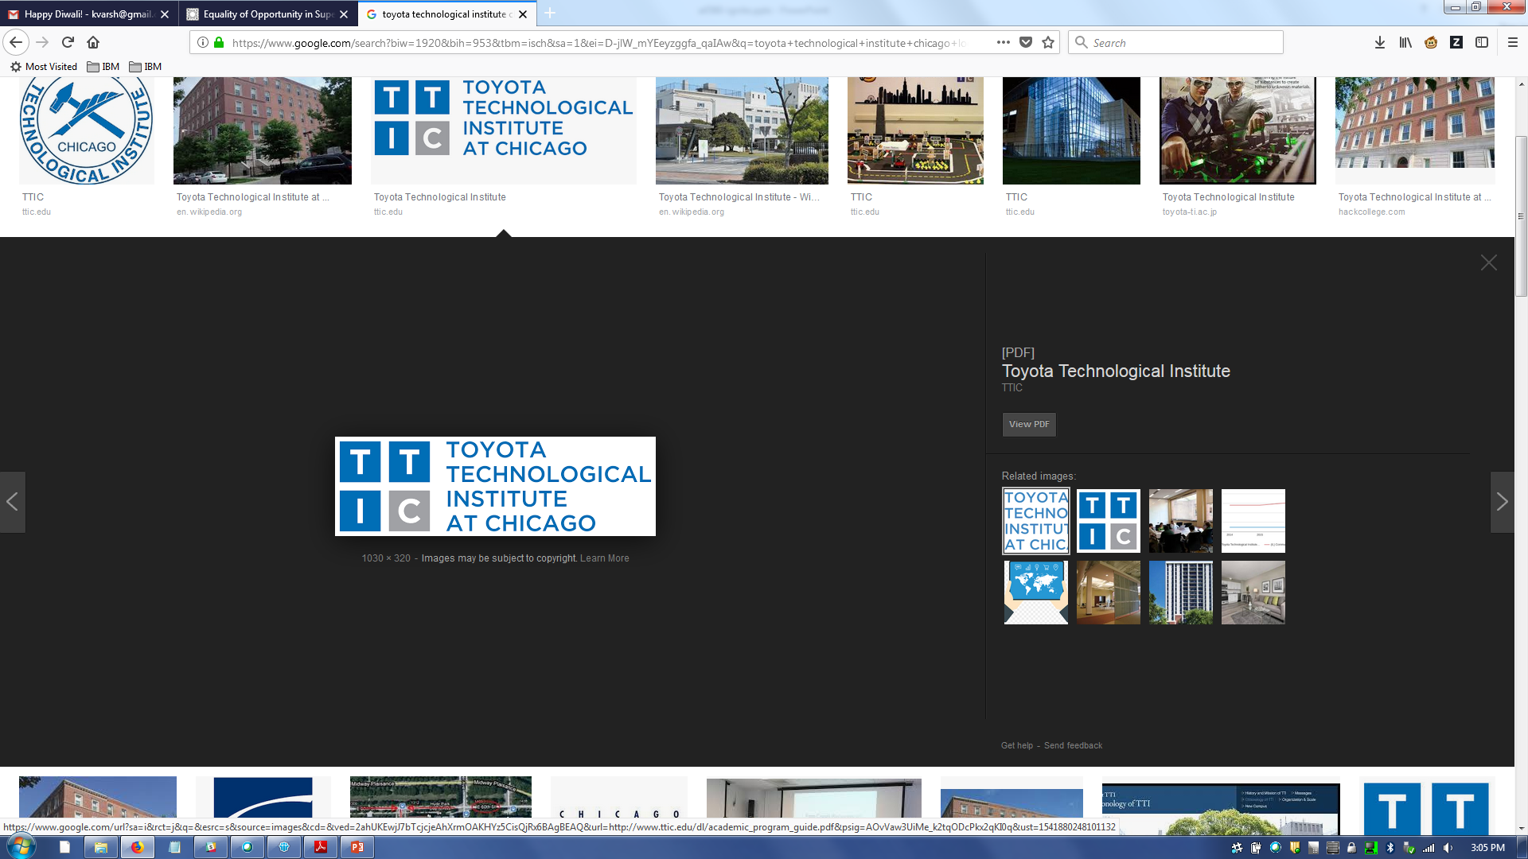







Bias mitigation algorithms
Optimized Preprocessing (Calmon et al., NIPS 2017)
Meta-Algorithm for Fair Classification (Celis et al., FAT* 2019)
Disparate Impact Remover (Feldman et al., KDD 2015)
Equalized Odds Postprocessing (Hardt et al., NIPS 2016)
Reweighing (Kamiran and Calders, KIS 2012)
Reject Option Classification (Kamiran et al., ICDM 2012)
Prejudice Remover Regularizer (Kamishima et al., ECML PKDD 2012)
Calibrated Equalized Odds Postprocessing (Pleiss et al., NIPS 2017)
Learning Fair Representations (Zemel et al., ICML 2013)
Adversarial Debiasing (Zhang et al., AIES 2018)

Slide 35
Metrics, algorithms, and explainers
dataset metric explainer
pre-processing algorithm
in-processing algorithm
dataset metric
post-processing algorithm
classifier metric
classifier metric explainer

Slide 36
Toolkit structure

Slide 37
Toolkit structure

Slide 38
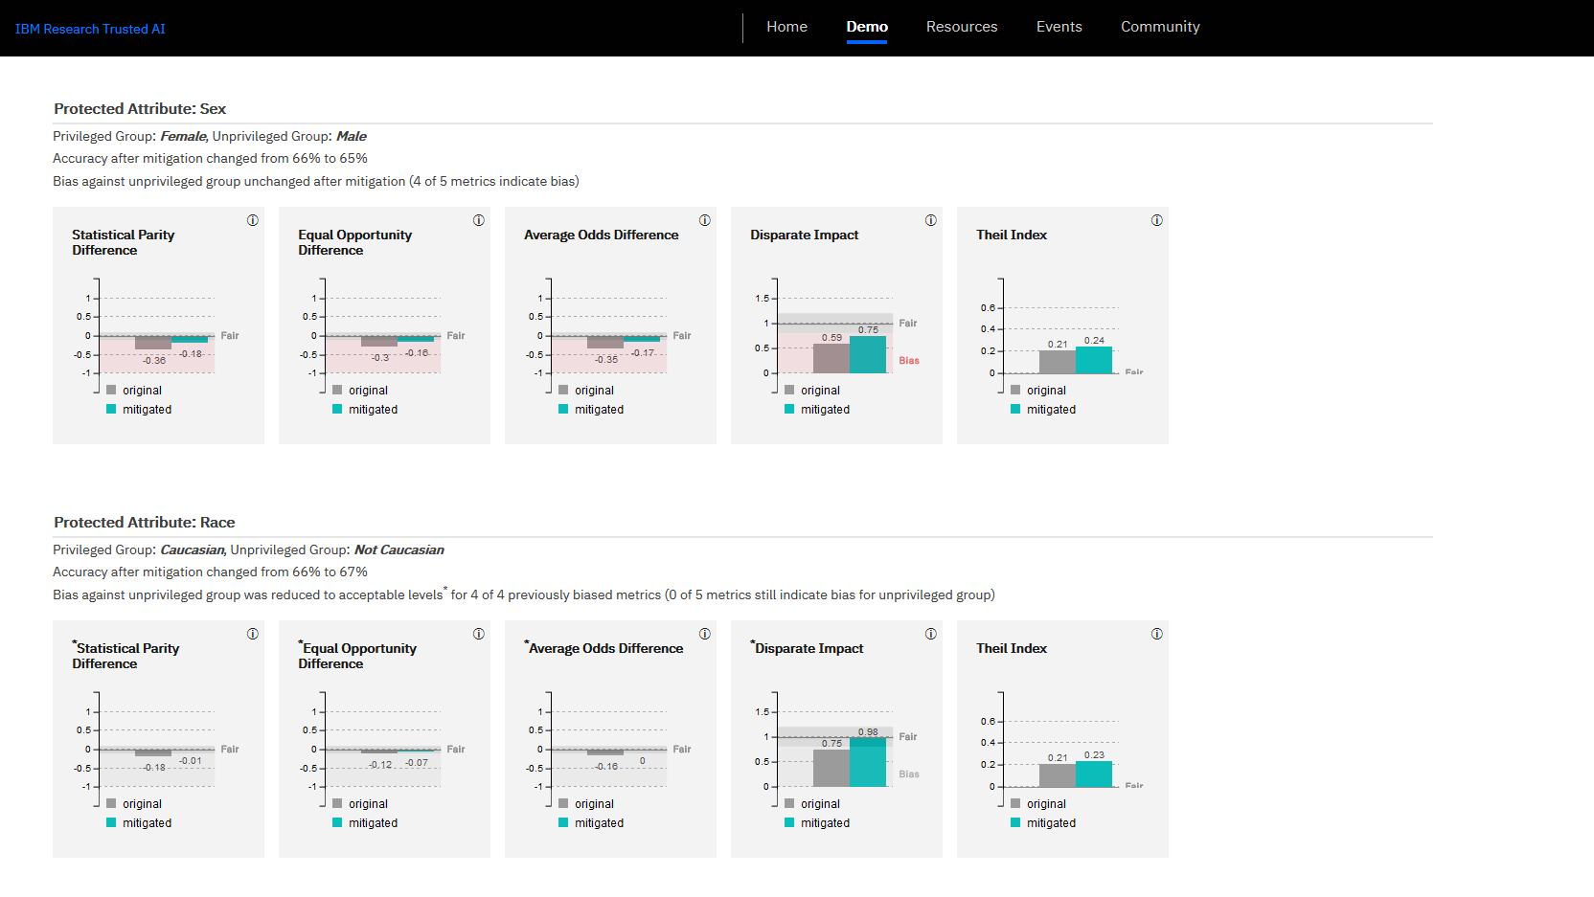

Slide 39
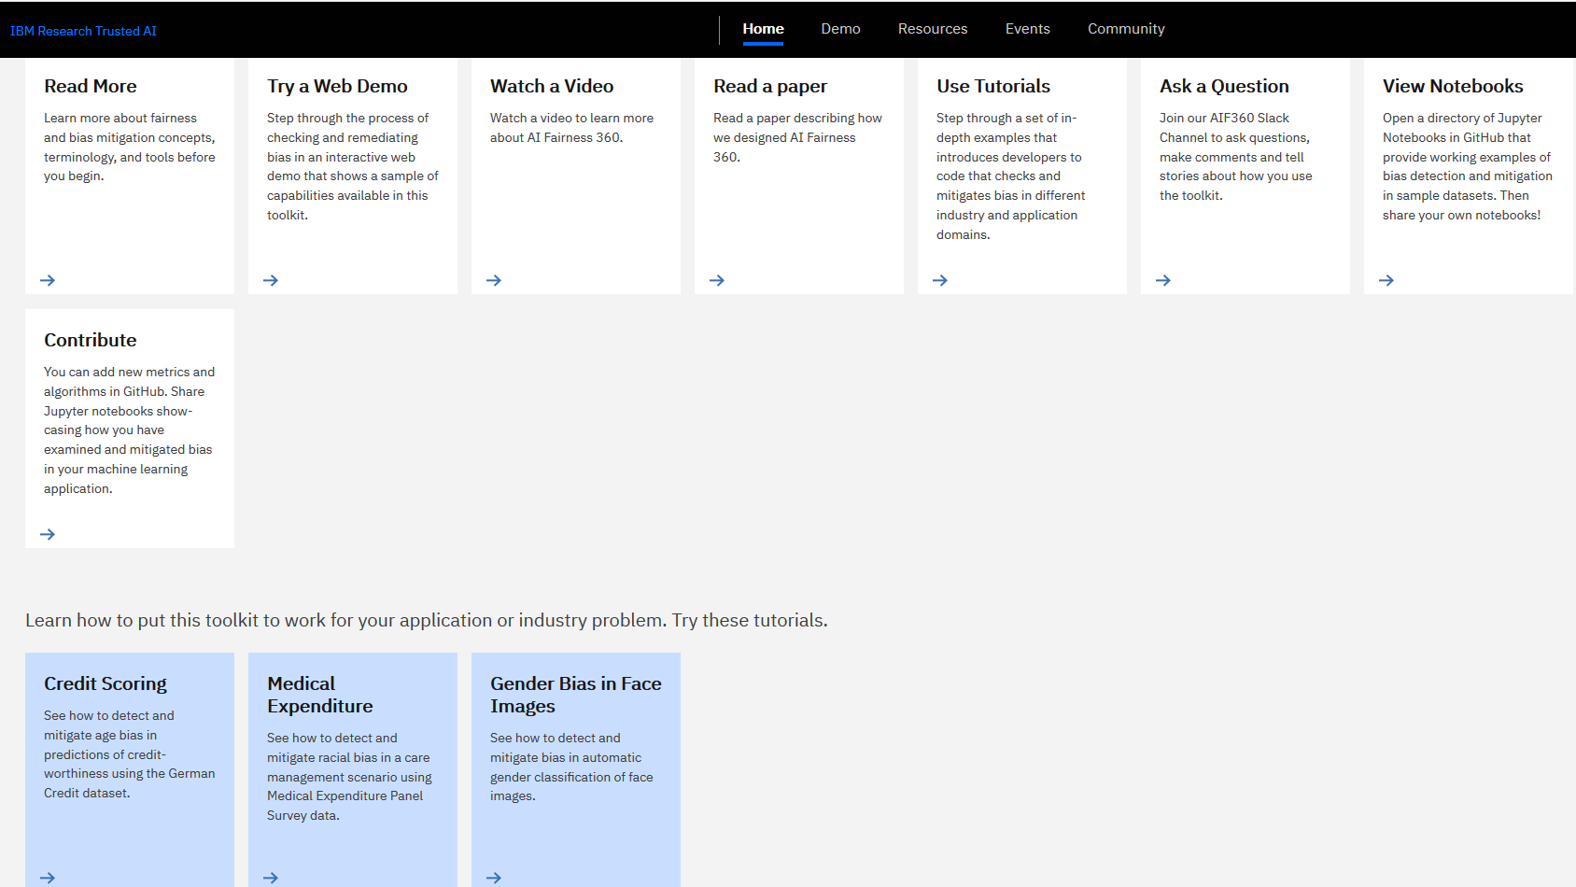

Slide 40


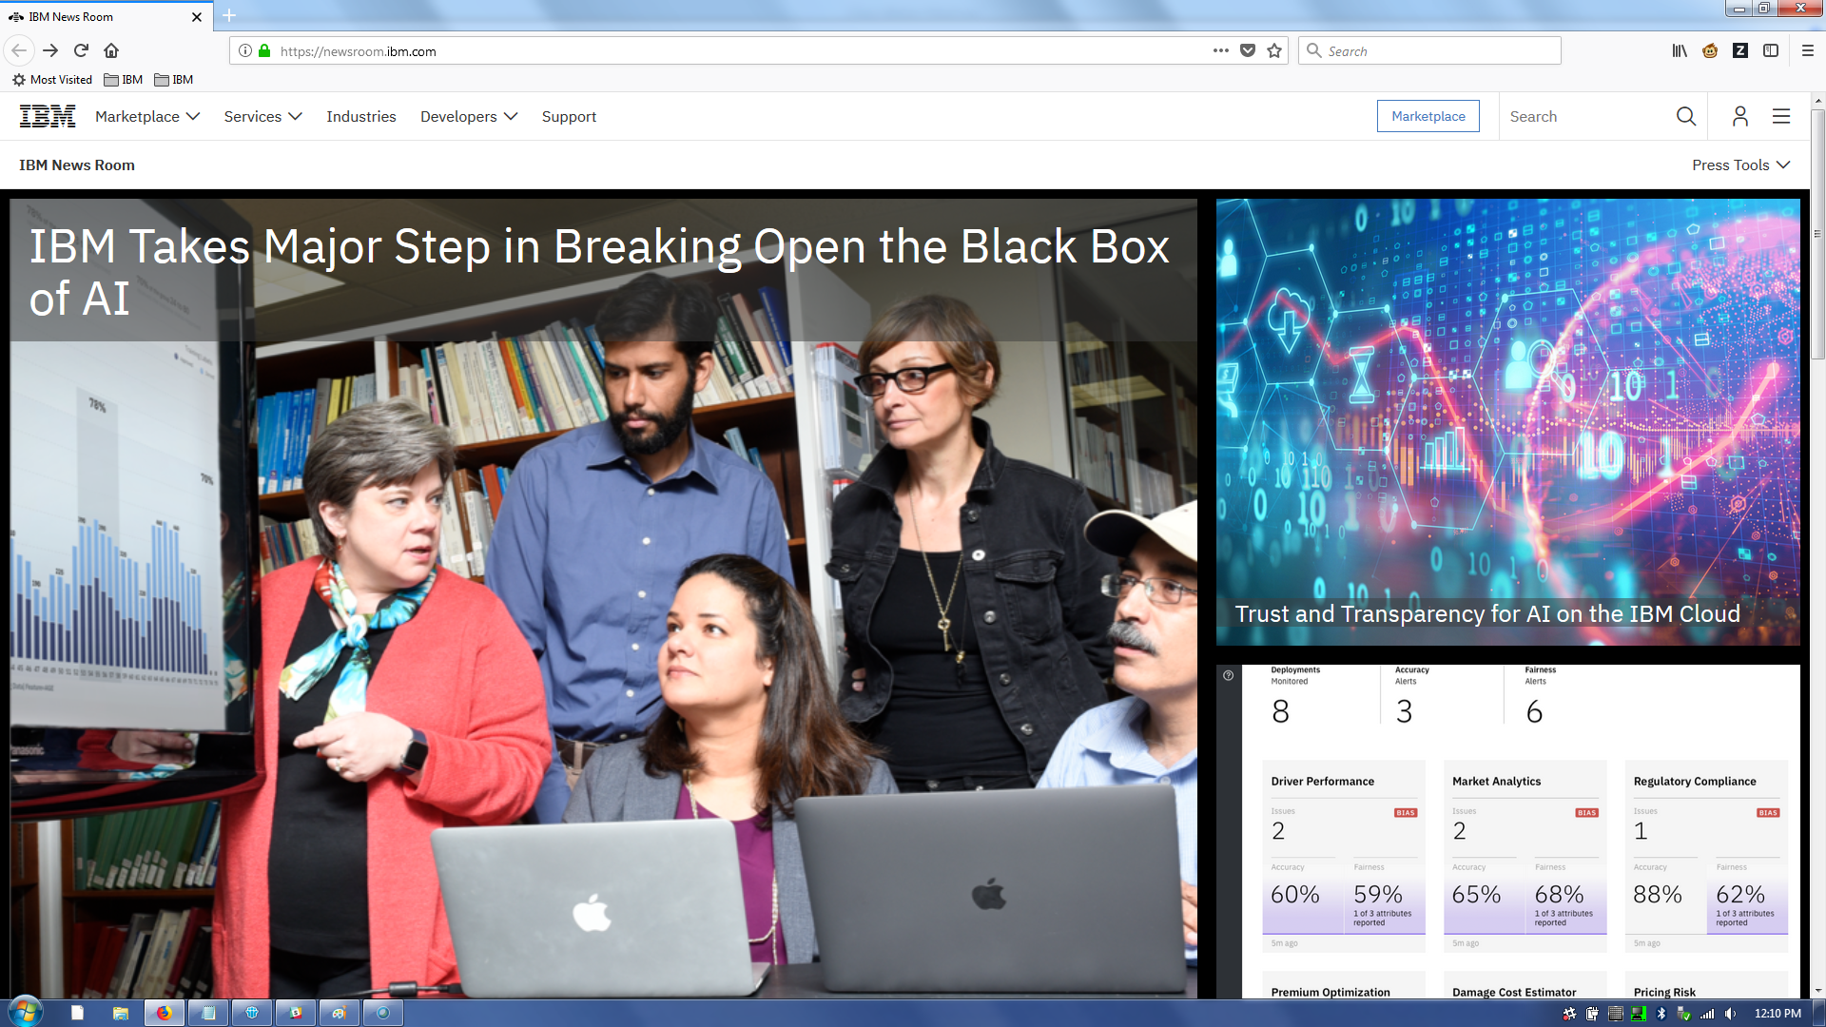
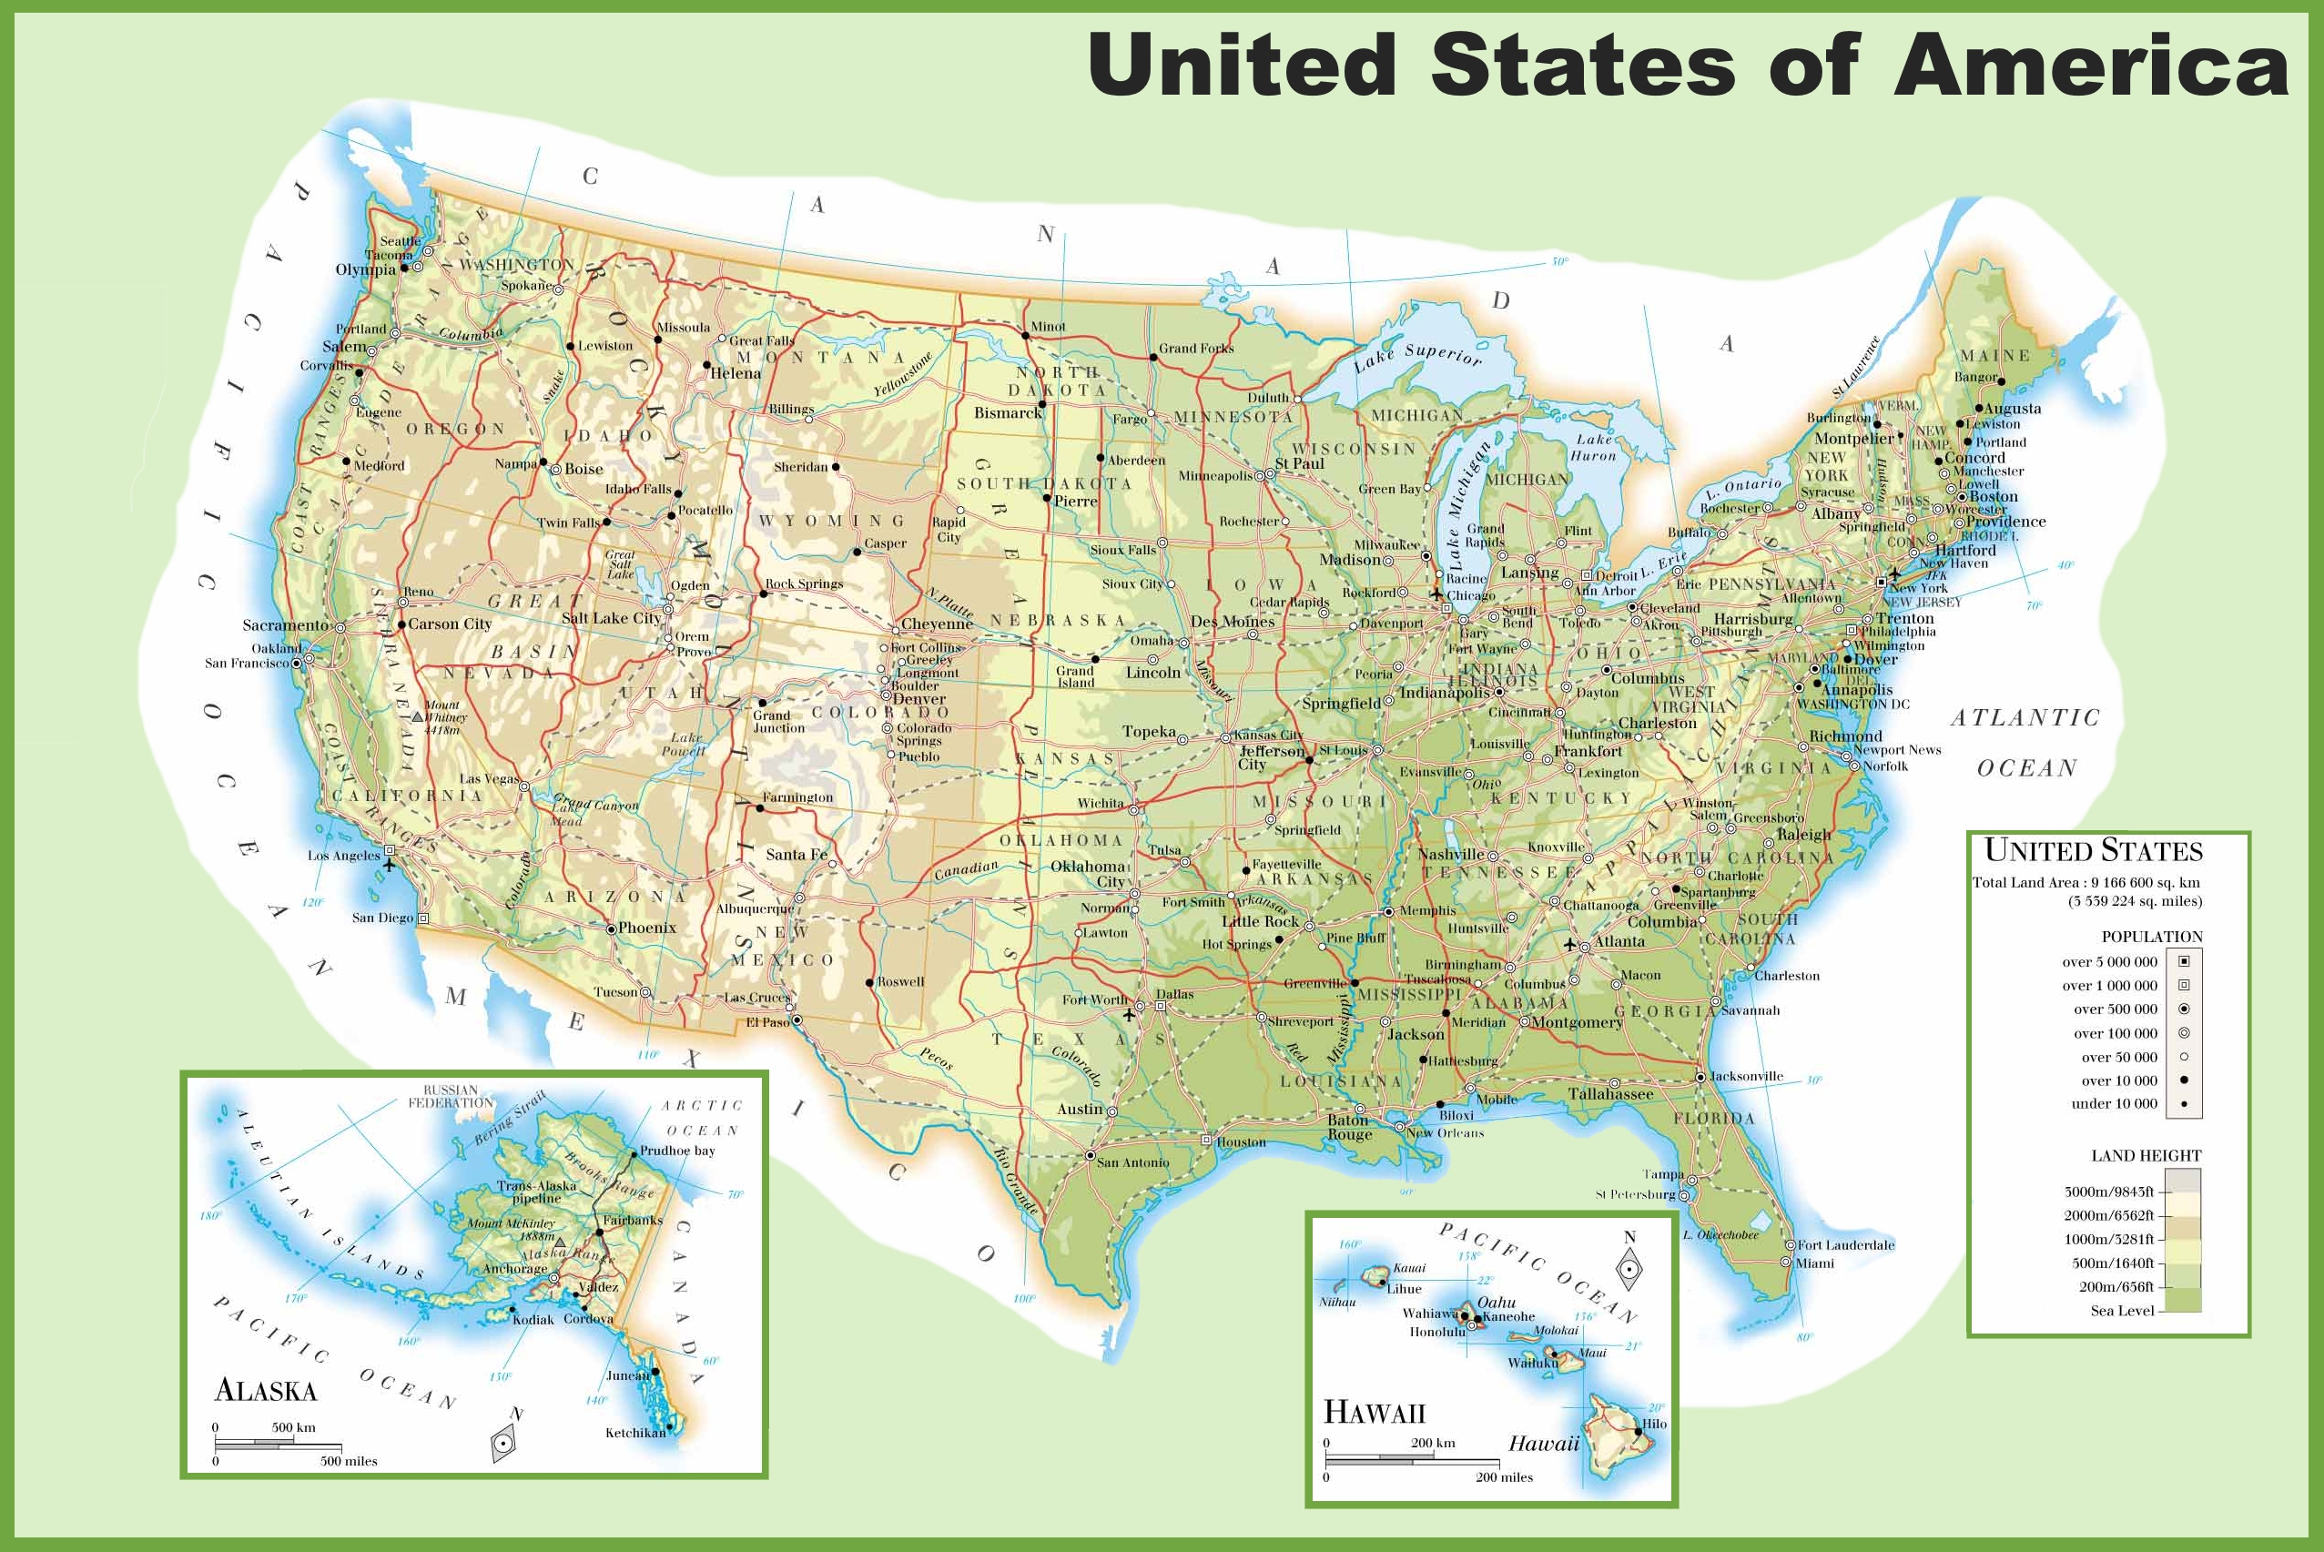


The team and our experience in putting the toolkit together
Rachel K. E. Bellamy, Kuntal Dey, Michael Hind, Samuel C. Hoffman, Stephanie Houde, Kalapriya Kannan, Pranay Lohia, Sameep Mehta, Aleksandra (Saška) Mojsilovic, Seema Nagar, Karthikeyan Natesan Ramamurthy, John Richards, Diptikalyan Saha, Prasanna Sattigeri, Moninder Singh, Kush R. Varshney, Yunfeng Zhang
Samya साम्या

Slide 41
AI Fairness 360
Agenda
Trustworthy machine learning Algorithmic Fairness AI Fairness 360 Toolkit Which fairness metric? Which bias mitigation algorithm?
Please join the Slack community http://aif360.mybluemix.net/community

Slide 42
Appropriateness of AIF360
Fairness is a multifaceted, context-dependent social construct that defies simple definition
The metrics and algorithms clearly do not capture the full scope of fairness in all situations
The toolkit should only be used in a very limited setting: allocation or risk assessment problems with well-defined protected attributes in which one would like to have some sort of statistical or mathematical notion of sameness
Only a starting point to a broader discussion among multiple stakeholders on overall decision making workflows

Slide 43
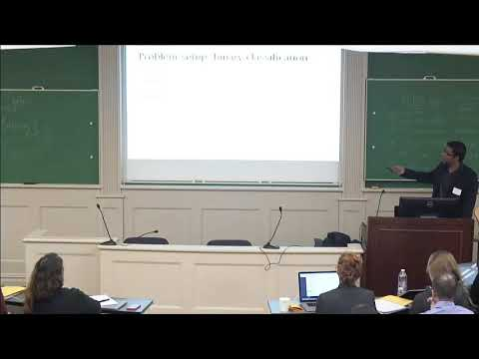
Definition dilemma
(Narayanan, 2018)

Slide 44
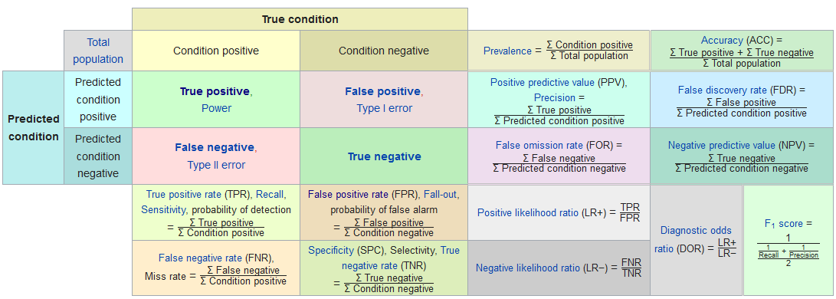
Confusion matrix confusion

Slide 45
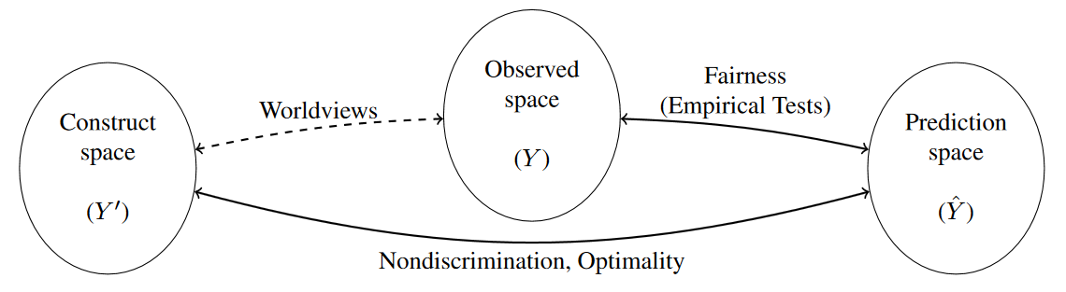
Worldview bewilderment
(Yeom and Tschantz, 2018)

Slide 46
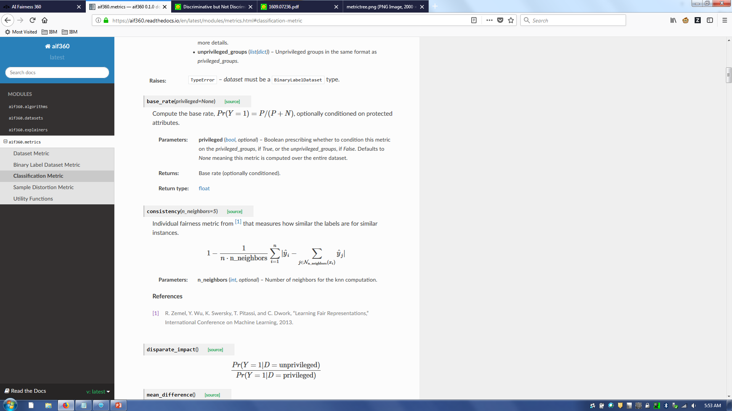
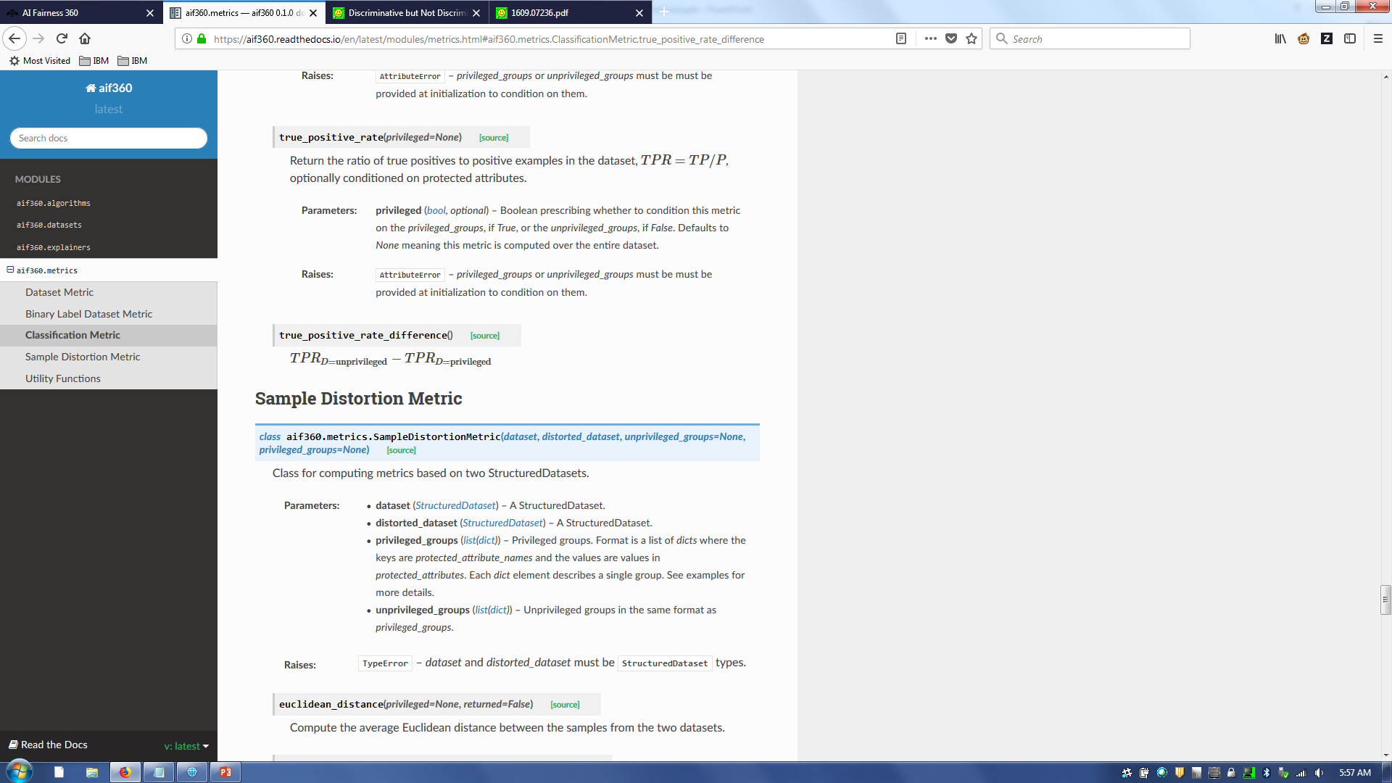
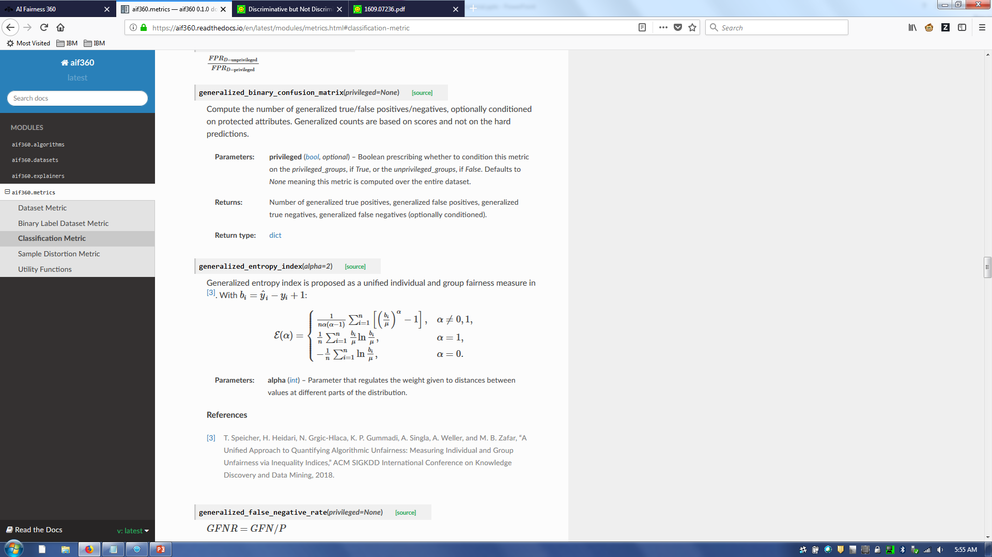
Consideration 1: Individual, group, or both

Slide 47
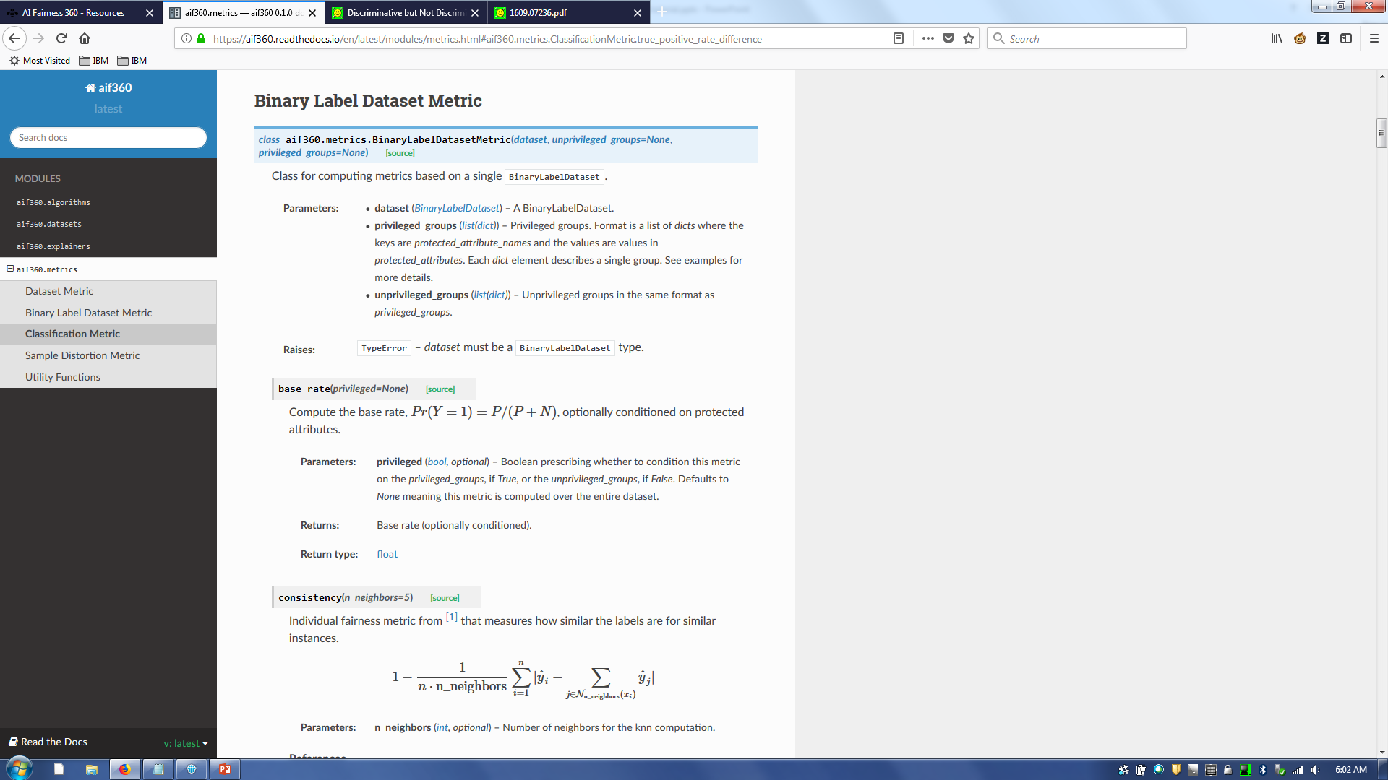
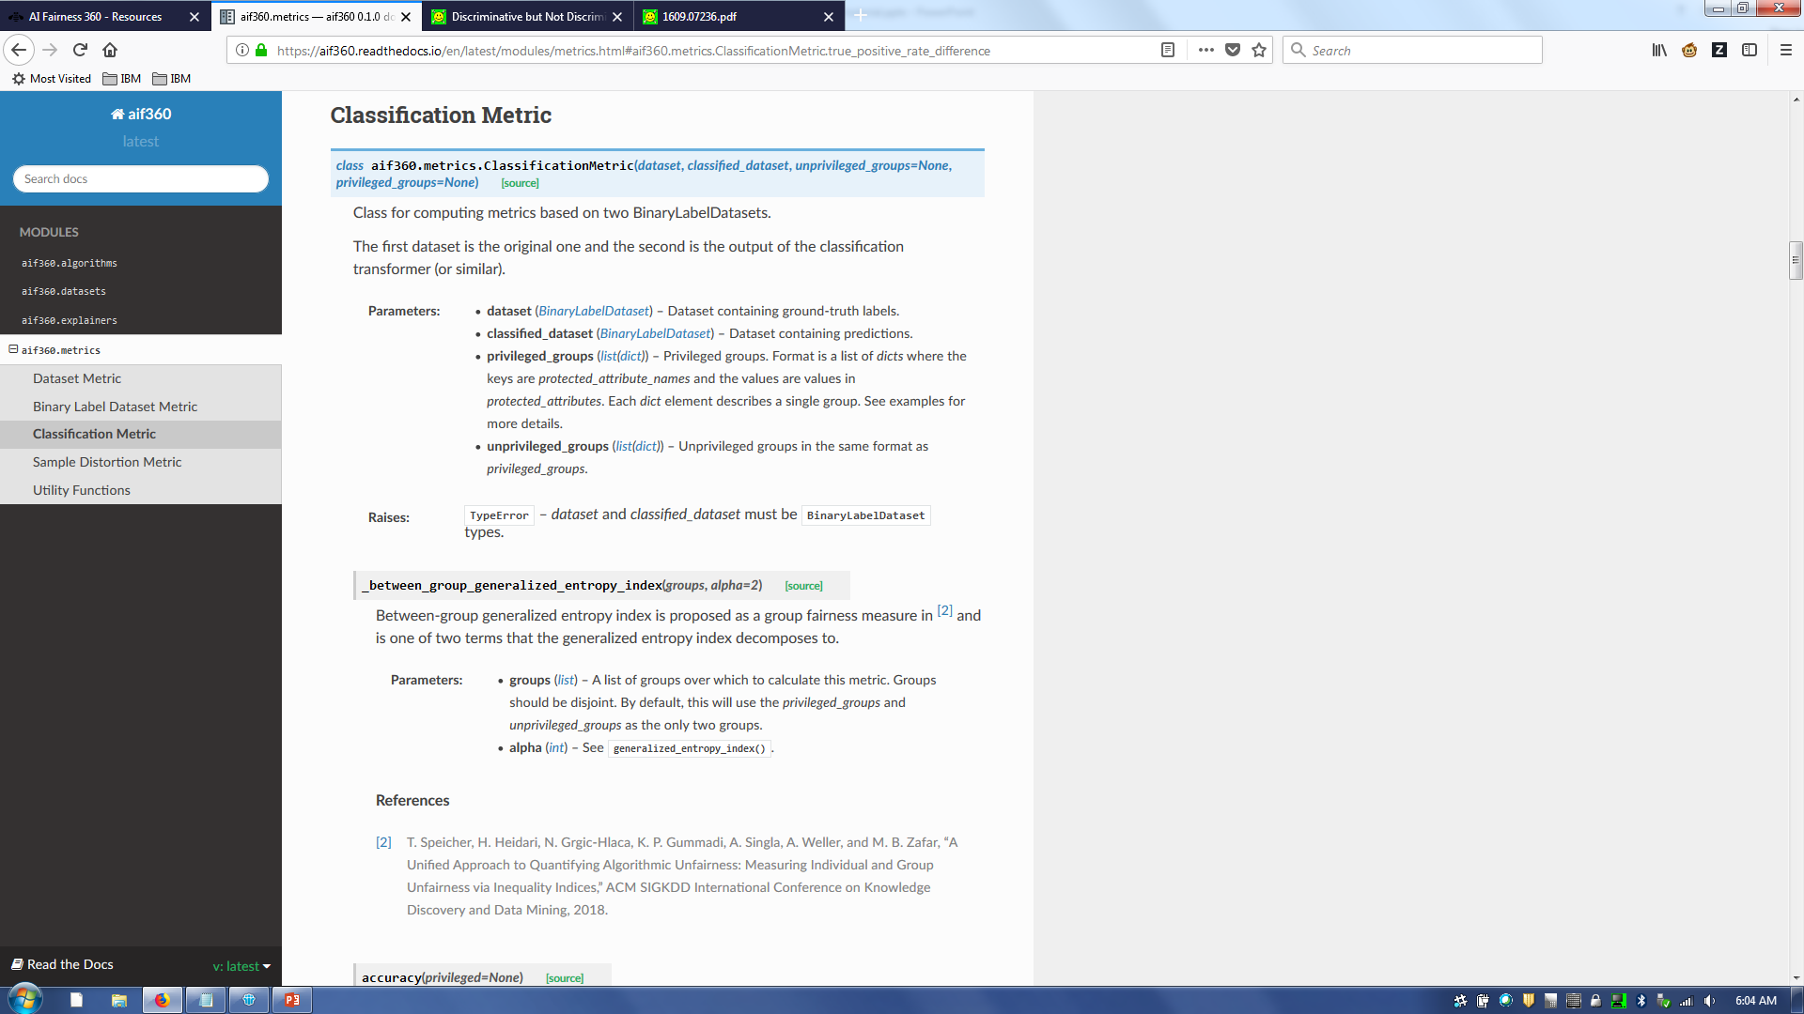


Consideration 2: Data vs. model

Slide 48
Consideration 3: What you see is what you get vs. we’re all equal
WYSIWYG in a College Admissions Decision
In the college admissions setting, the WYSIWYG is the assumption that features like SAT scores and high-school GPA (which are observed) correlate well with the applicant’s ability to succeed (a property of the construct space). More precisely, it assumes that there is some way to use a combination of these scores to correctly compare true applicant ability. → average odds difference
WAE in a College Admissions Decision
In the college admissions setting, the WAE asserts that all groups will have almost the same distribution in the construct space of intrinsic abilities, such as grit or intelligence, chosen as important inputs to the decision making process. In the example of SAT scores, given above, this would mean that we assume the structural bias of these scores apparent in the observed space is not representative of a distributional difference in the construct space. → disparate impact, statistical parity difference
(Friedler et al., 2016)

Slide 49
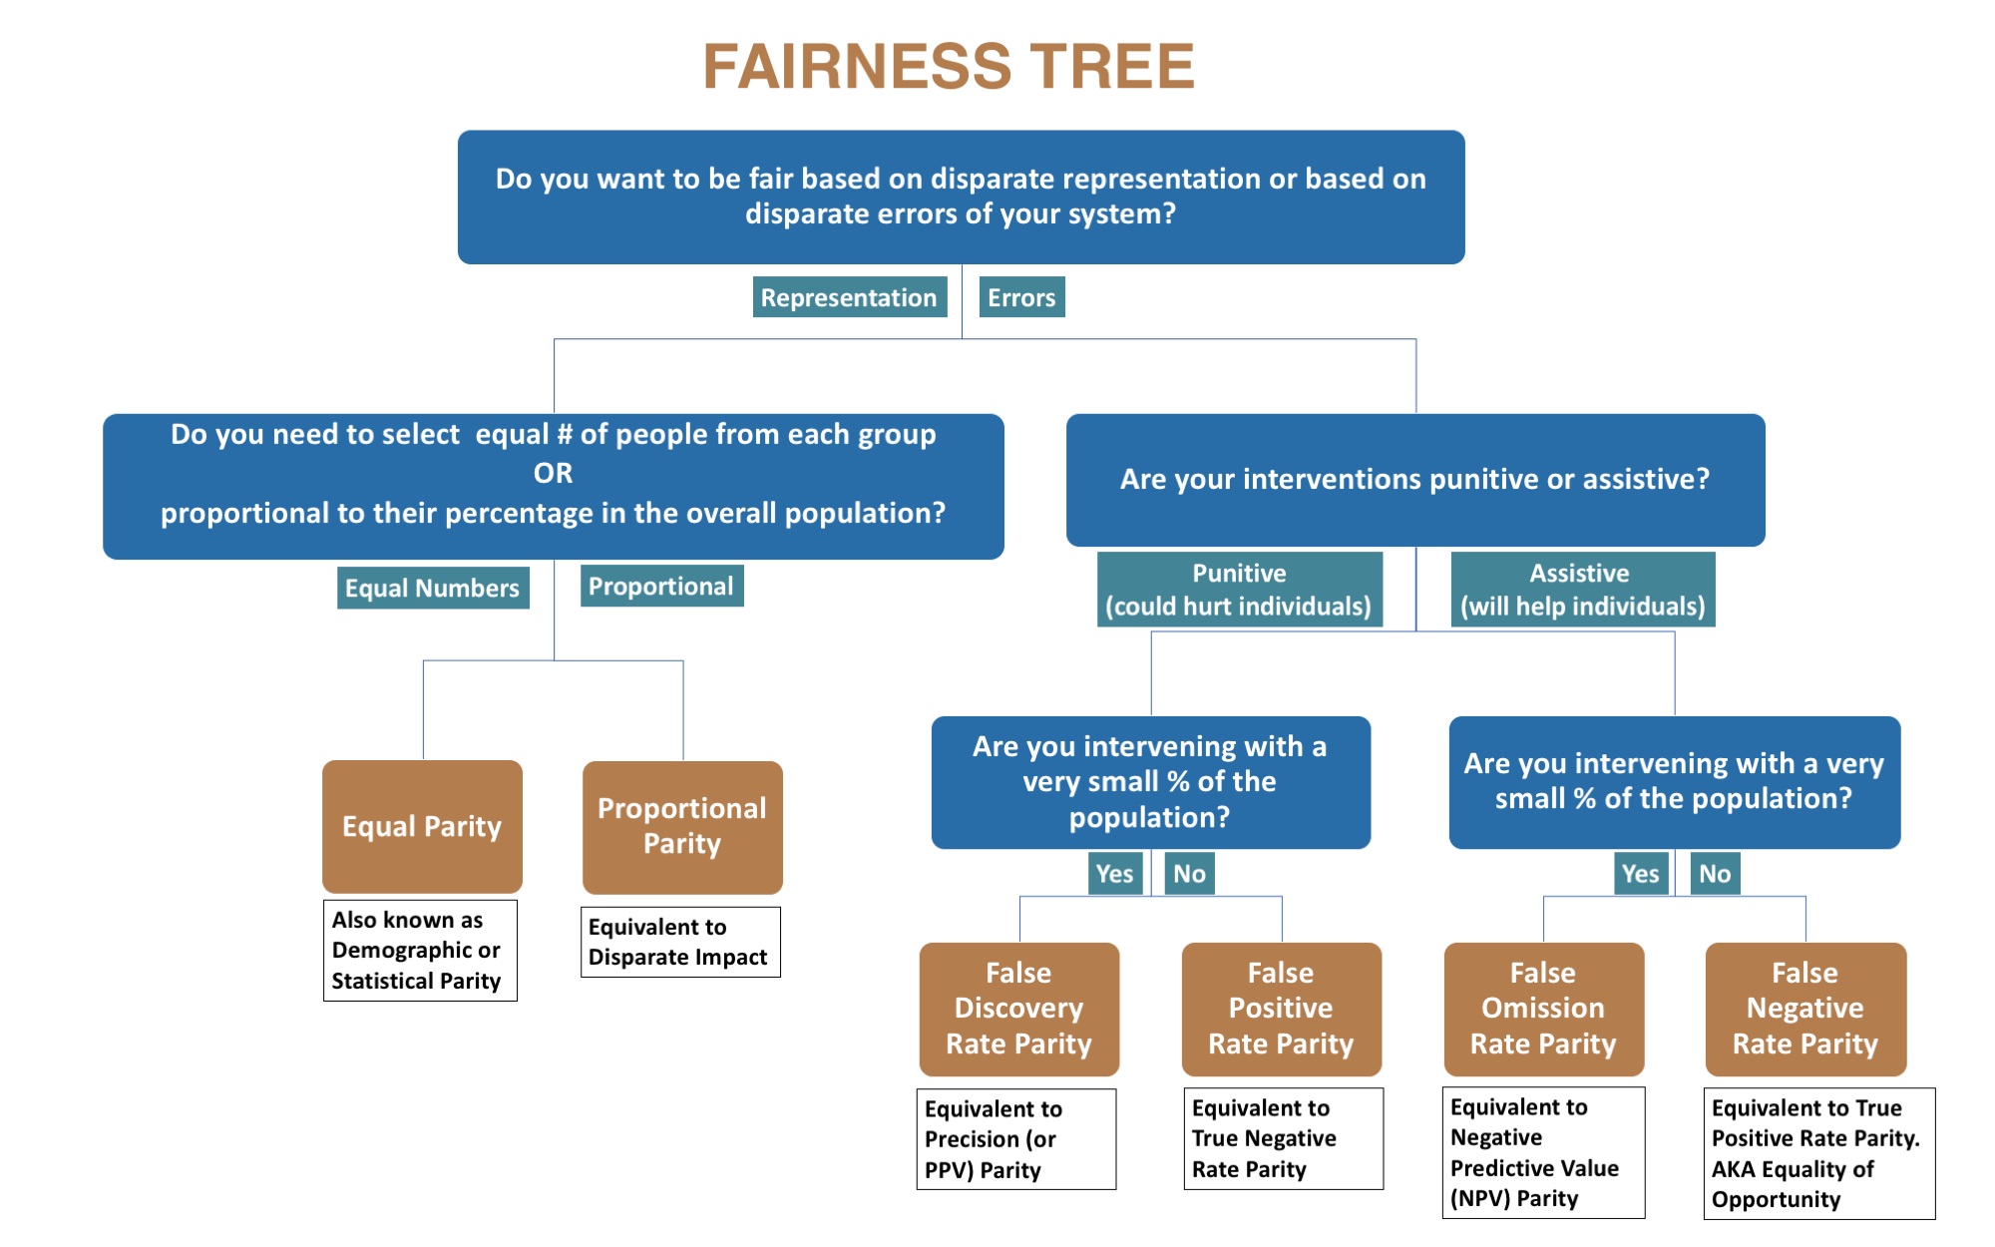
Aequitas fairness tree
http://aequitas.dssg.io/static/images/metrictree.png

Slide 50
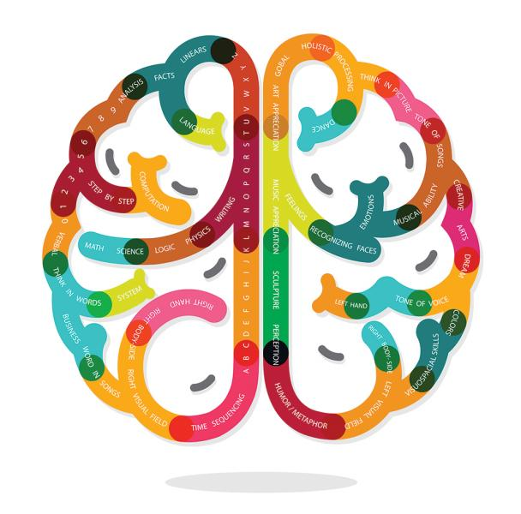
Consideration 4: Ratios vs. differences

Slide 51
AI Fairness 360
Agenda
Trustworthy machine learning Algorithmic Fairness AI Fairness 360 Toolkit Which fairness metric? Which bias mitigation algorithm?
Please join the Slack community http://aif360.mybluemix.net/community

Slide 52
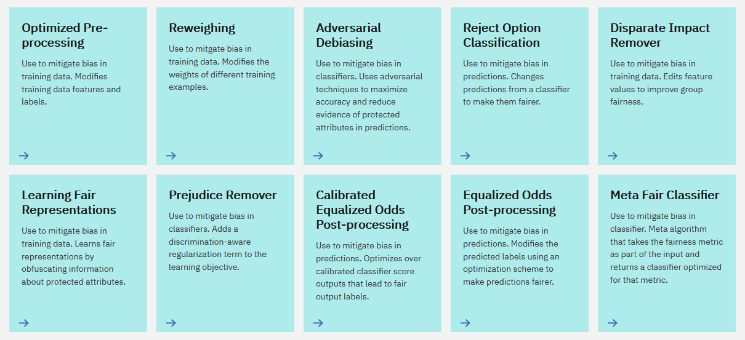
Lots of different algorithms – Which to choose?

Slide 53
Three categories of bias mitigation algorithms
Pre-processing algorithm – a bias mitigation algorithm that is applied to training data
In-processing algorithm – a bias mitigation algorithm that is applied to a model during its training
Post-processing algorithm – a bias mitigation algorithm that is applied to predicted labels
The choice among algorithm categories can partially be made based on the user persona’s ability to intervene at different parts of a machine learning pipeline.
If the user is allowed to modify the training data, then pre-processing can be used.
If the user is allowed to change the learning algorithm, then in-processing can be used.
If the user can only treat the learned model as a black box without any ability to modify the training data or learning algorithm, then only post-processing can be used.

Slide 54
Pre-processing if possible
AIF360 recommends the earliest mitigation category in the pipeline that the user has permission to apply.
Most flexibility.
Most opportunity to correct bias as much as possible.
Multiple stages of mitigation are possible, but perhaps overkill.

Slide 55
No free lunch
‘No free lunch theorem’ of machine learning generalization accuracy: there is no one best algorithm independent of dataset.
Same thing for fairness metrics.
Also, some algorithms are matched to certain specific fairness metrics.
If possible, test all algorithms from all permissible categories. Straightforward due to unified architecture of AIF360.
The ultimate performance depends on dataset characteristics.
Correlation between different fairness metrics. Even an algorithm designed for one fairness metric may do well on another one of interest.

Slide 56
AI Fairness 360
http://aif360.mybluemix.net https://github.com/ibm/aif360 https://pypi.org/project/aif360
Please join the Slack community http://aif360.mybluemix.net/community

